Slide 1
GLORIOUS
Gifts

Slide 2

PROJECT TITLE: GLORIOUS GIFTS
By Semester- V of III Year M.Sc. (2023-24)
Submitted By: -
Urvashi Padhiyar: - 3043
Sanskruti Darji: - 3200
Khushbu Parmar: - 3230
Group ID: - 26
Submitted to: - K.S. School of Business Management and IT
M.Sc.- Computer Applications and Information Technology.

Slide 3
Existing System:
Currently, we do not have any system for gift selling, all work is done manually.
In Existing system customers have to visit the shop and select the gifts what they want to buy.
Every transaction is done face to face.
Existing system is very time consuming and also there is a time and location barrier for the customers.
We have referred some website like: -
https://www.winni.in/gifts
https://giftcart.com
https://www.indiagift.in
https://www.giftalove.com

Slide 4
Proposed System:
The proposed system has many advantages over existing system.
Our proposed system will work in less time and effort for selling gifts with more efficiency
and productivity of work.
New features and functionality in proposed system which would
make our shop much better for easily reaching out to our customer.
Some of the functions of our proposed system that attract customers to choose our website to
buy gifts:
Suggestion box that suggests customer according to age group to buy gifts.
Customers will get notification as new gifts uploaded on our website to buy it with
discount.
Take help for alteration.

Slide 5
Scope of System:
Simply go to website do sign up and login in our system.
After that, you can search for gifts, get suggestion and details about trendy fashionable gifts and can purchase anytime at Glorious Gifts.

Slide 6
Stakeholders of System:
There are 3 stakeholders for our website:
Admin
User
Visitor

Slide 7
Admin:
Admin will be log in website and can view order details and customer details.
Admin can Reviews web content, links, and design, provides necessary updates and enhancements in a timely manner.
Admin would confirm the product for adding it into website.
Admin will Monitors site security, reports suspected or actual security breaches and denial of service attacks to appropriate staff.

Slide 8
User:
To buy any product user will have to first register themselves.
After registration user will have to log in with the correct password and the email id.
User can search any gift products and buy it with minimum period of time.
If the use forgets their password then they can reset it using verification code provided by server.

Slide 9
Visitor:
Visitors can view the various products from websites.
Visitor Needs to create account on website to purchase products.

Slide 10
Project Definition
“Glorious Gifts”
The website is an online gift shopping platform offering a wide range of products in different categories. Users can conveniently browse and purchase gifts, make online payments, or opt for cash on delivery. The platform aims to streamline the gift selection process, allowing users to find the perfect gift for various occasions and recipients. It provides detailed product information, user reviews, and a suggestion box for personalized recommendations. Users can also utilize the search bar and voice search feature to quickly find specific gift products.

Slide 11
Feasibility study:
“A feasibility study is a detailed analysis that considers all of the critical aspects of a proposed project in order to determine the likelihood of it succeeding.”
Although feasibility studies can help project managers determine the risk and return of pursuing a plan of action, several steps should be considered before moving forward.
The main aim of the feasibility study is to determine that it would be financially and technically feasible to develop the System. The purpose of feasibility study is not to solve the problem, but to determine whether the problem is worth solving.

Slide 12
I. ECONOMIC FEASIBILITY
▪ As there is no paperwork required so it reduce the cost of working it manually.
▪ All people are aware of new technology so there is no problem to run the system and no special skills are required.
▪ To use and make the system nominal cost is required at client side and server side some hardware and software required only.
▪ At the time of development there should be one thing in mind that the system should not much costly to develop.
Possible questions raised in economic analysis are:
1.Is the system cost effective? 3.The cost of business employee time
2.Do benefits outweigh cost? 4.The cost of doing full system study
5. Estimated cost of hardware

Slide 13
TECHNICAL FEASIBILITY
“The process of proving that the concept is technically possible”.
The technology is stable and established, resource is easily available/accessible and also expertise is available. No special hardware or software is required. So, the system is technically feasible.
Internet is required to use the system.
The technical feasibility will usually result in knowledge about the product or process design, performance, production requirements, and preliminary production costs.
If the system is capable of producing outputs in a given time, response time under certain conditions and the organization is having the required gadgets then a proposed system can be technically feasible.

Slide 14
III. OPERATIONAL FEASIBILITY
“Operational feasibility is the measure of how well a proposed system solves the problems, and takes advantages of the opportunities identified during scope definition and how it satisfies the requirements identified in the requirements analysis phase of system development”.
Operational feasibility is a critical aspect of systems engineering that needs to be an integral part of the early design phases.

Slide 15



HARDWARE AND SOFTWARE REQUIREMENT:
SYSTEM REQUIREMENT
PLATFORM:
PHP
FRONTEND:
HTML
CSS
JavaScript
BACKEND:
MYSQL

Slide 16
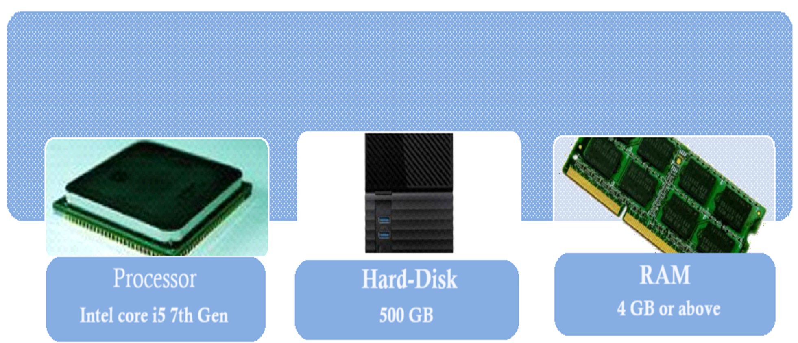
HARDWARE REQUIREMENT

Slide 17
System Planning:
Here’s some points about System planning,
Work Breakdown Structure.
Gantt chart.

Slide 18
WORK BREAKDOWN STRUCTURE
▪ Definition of Work Breakdown Structure-
“Deliverable oriented hierarchical decomposition of the work to be executed by the project team”.
-Project Management Institute (PMI).
Project Management Book of Knowledge(PMBOK)
▪ A work breakdown structure can show control points and milestones.
▪ WBS provides the visual of entire scope.

Slide 19
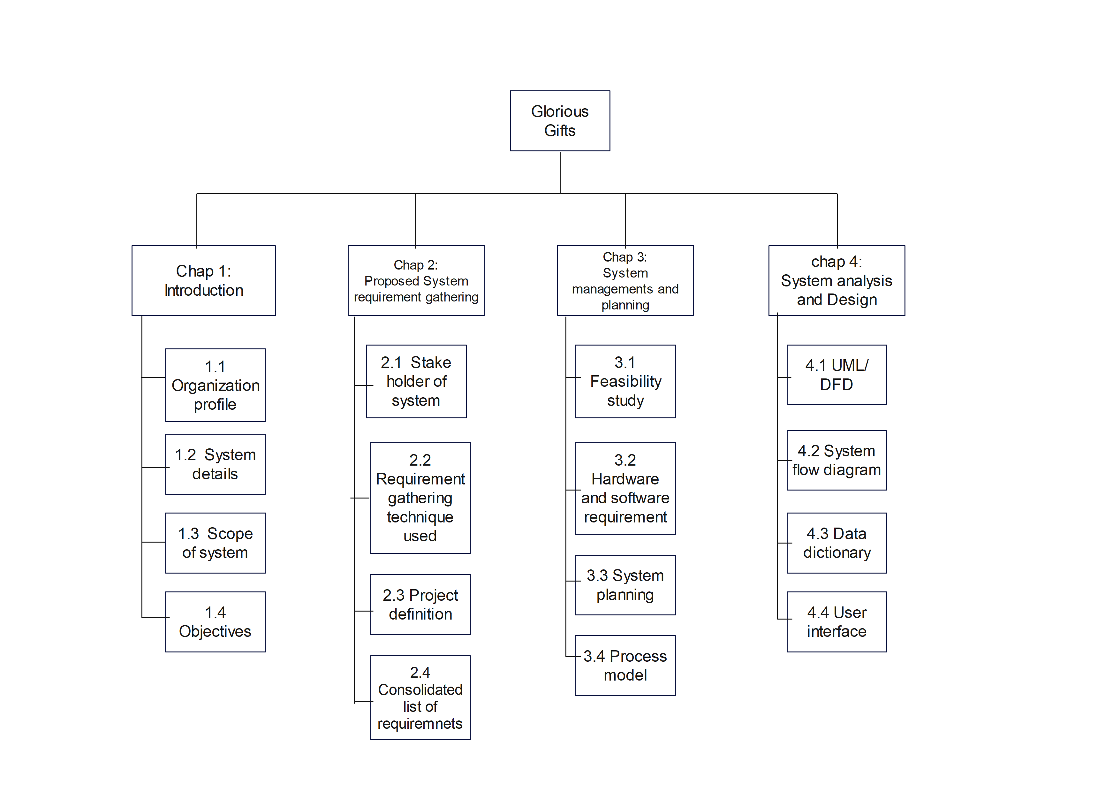

WORK BREAKDOWN STRUCTURE

Slide 20
GANTT CHART
A Gantt chart is a horizontal bar chart developed as a production control tool in 1917 by Henry L. Gantt, an American engineer and social scientist. Frequently used in project management, a Gantt chart provides a graphical illustration of a schedule that helps to plan, coordinate, and track specific tasks in a project.
A Gantt chart, commonly used in project management, is one of the most popular and useful ways of showing activities (tasks or events) displayed against time.
On the left of the chart is a list of the activities and along the top is a suitable time scale.

Slide 21
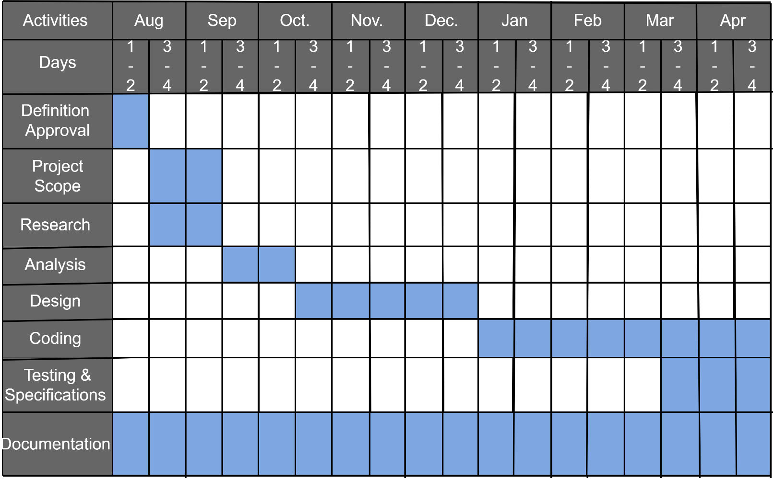
GANTT CHART

Slide 22
UML Diagram
I. Use case:
▪ The use case model for system consist of a set if use cases. Intuitively, use cases represent the different ways in which the users can use a system. Following is the use case representation of the advantages immigration system.
▪ Use case diagram is a graphic depiction of the interactions among the elements of a system. A Use case is methodology used in system analysis to identify, clarity and organize system requirements.

Slide 23

 | Boundary of the System
 | Actor of the system
 | For Use case
 | Connector between Actor and Use Case

Slide 24
Admin Use case

Slide 25
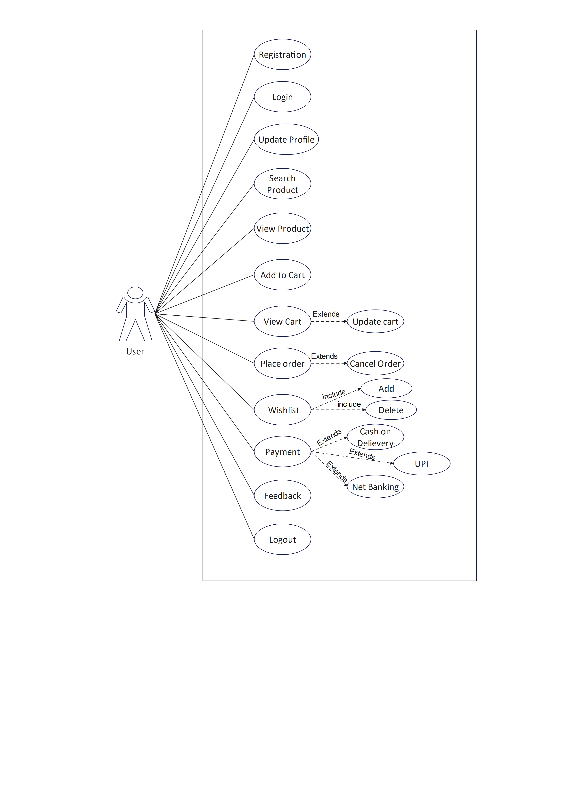
User Use case

Slide 26
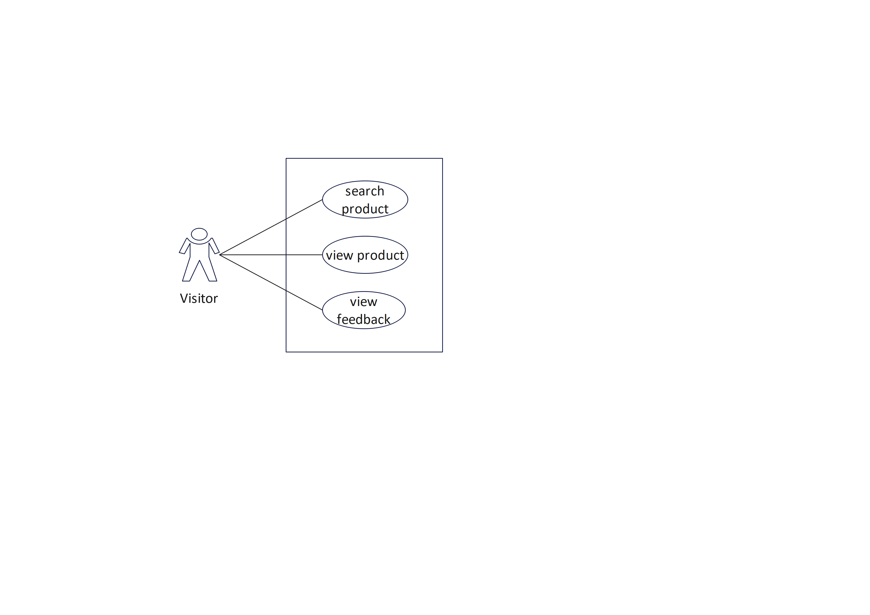
Visitor Use case

Slide 27
II. Class Diagram
A class comprises of three sections:
i. Class name
ii. Structure(attributes)
iii. Behaviour(operations)

Slide 28
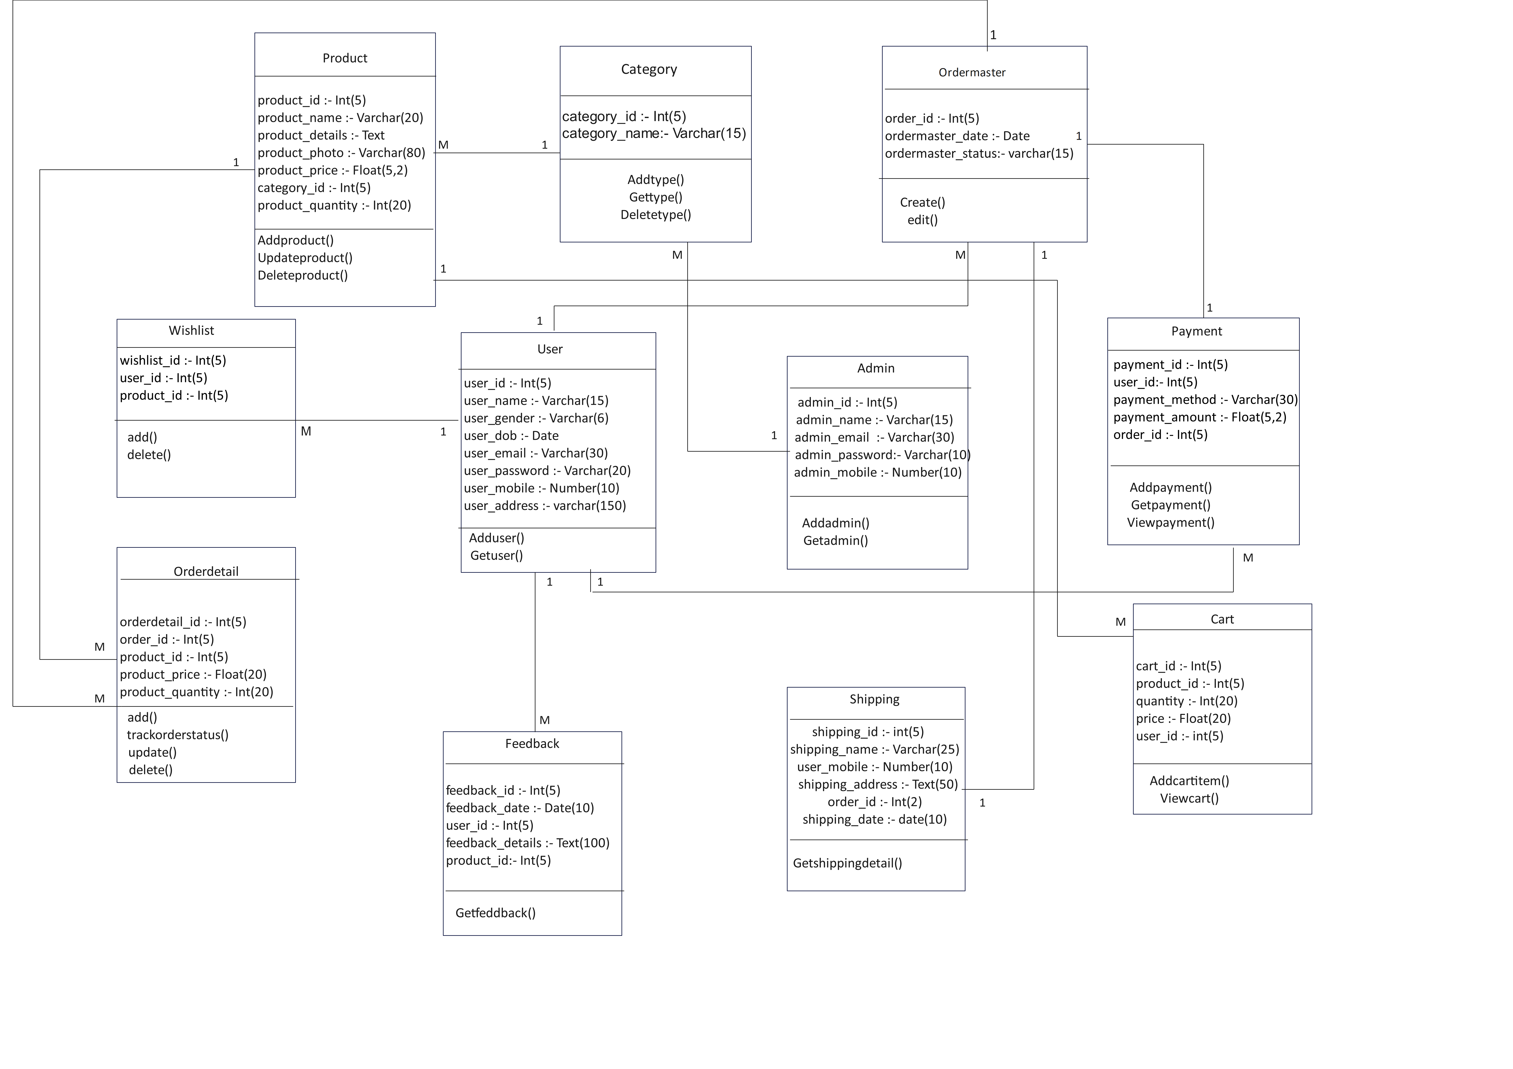

Slide 29
III. Activity Diagram:
Activity diagram is another important diagram in UML diagram describe dynamic aspects of the system. Activity diagram is basically a flow chart to represent the flow from one activity to another activity. The activity can be describe as an operation of the system.

Slide 30
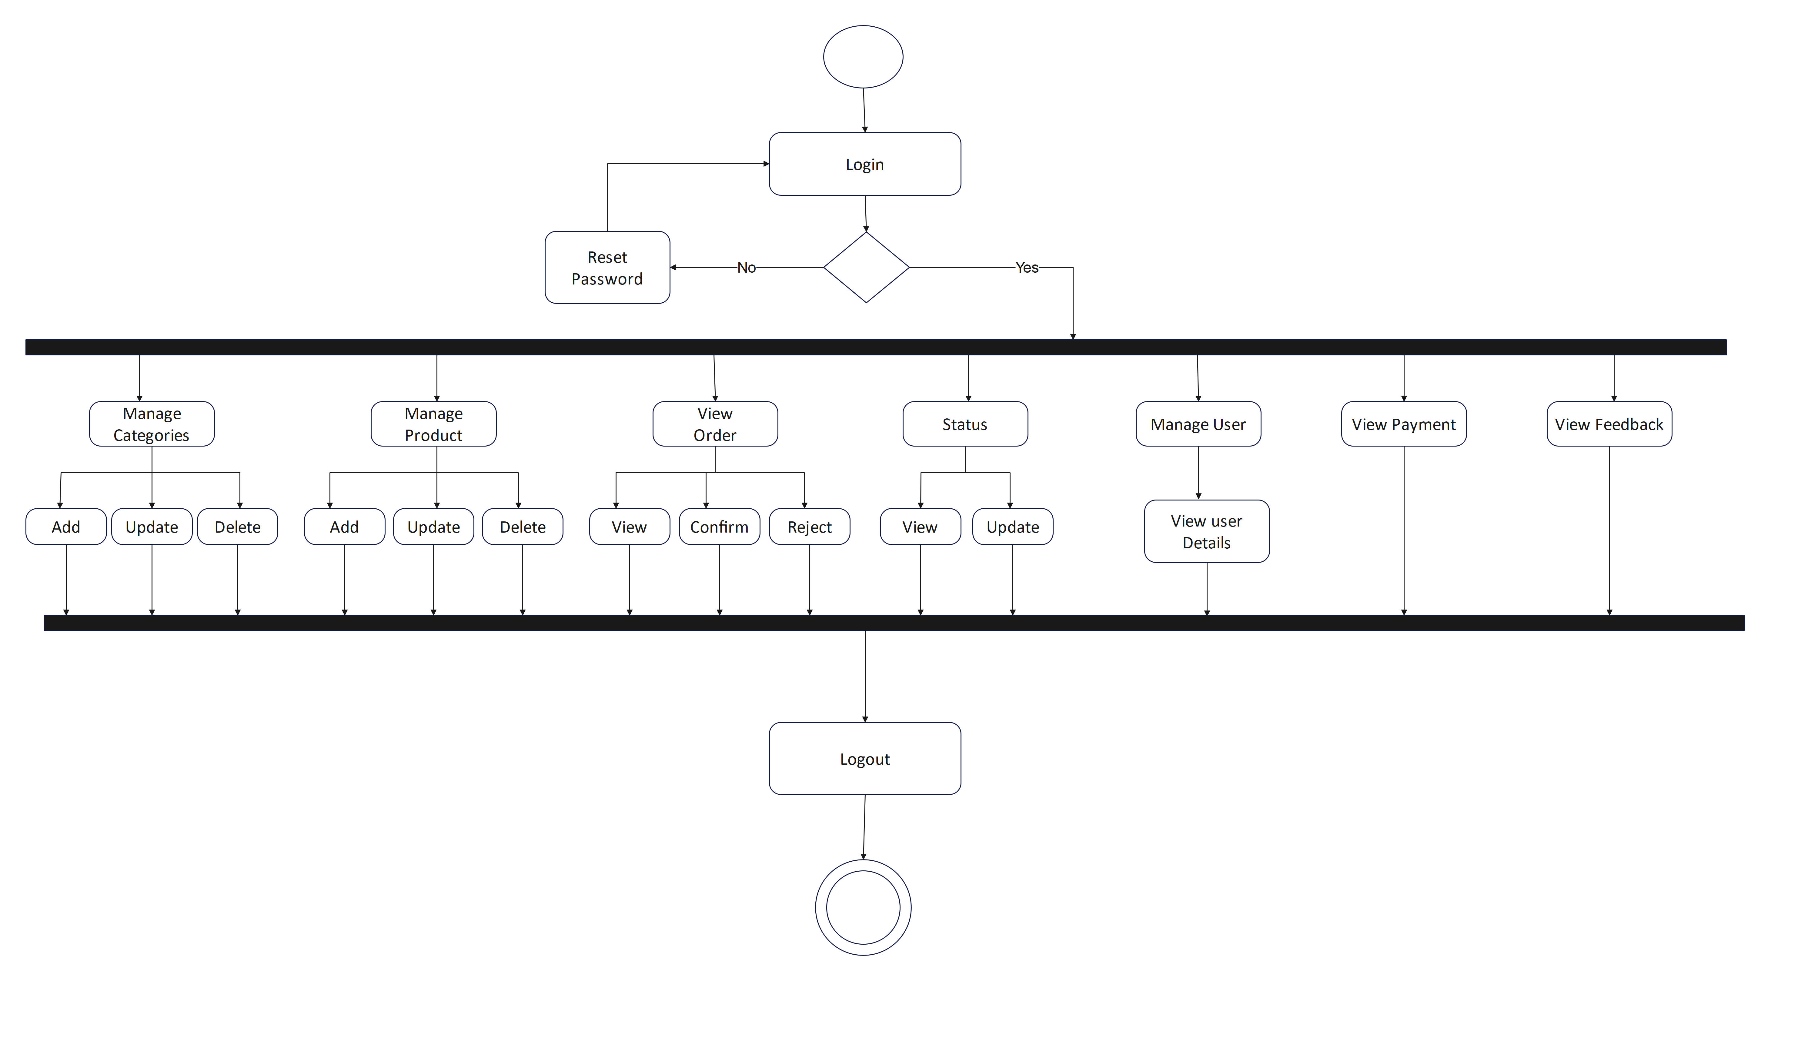
Activity Admin

Slide 31
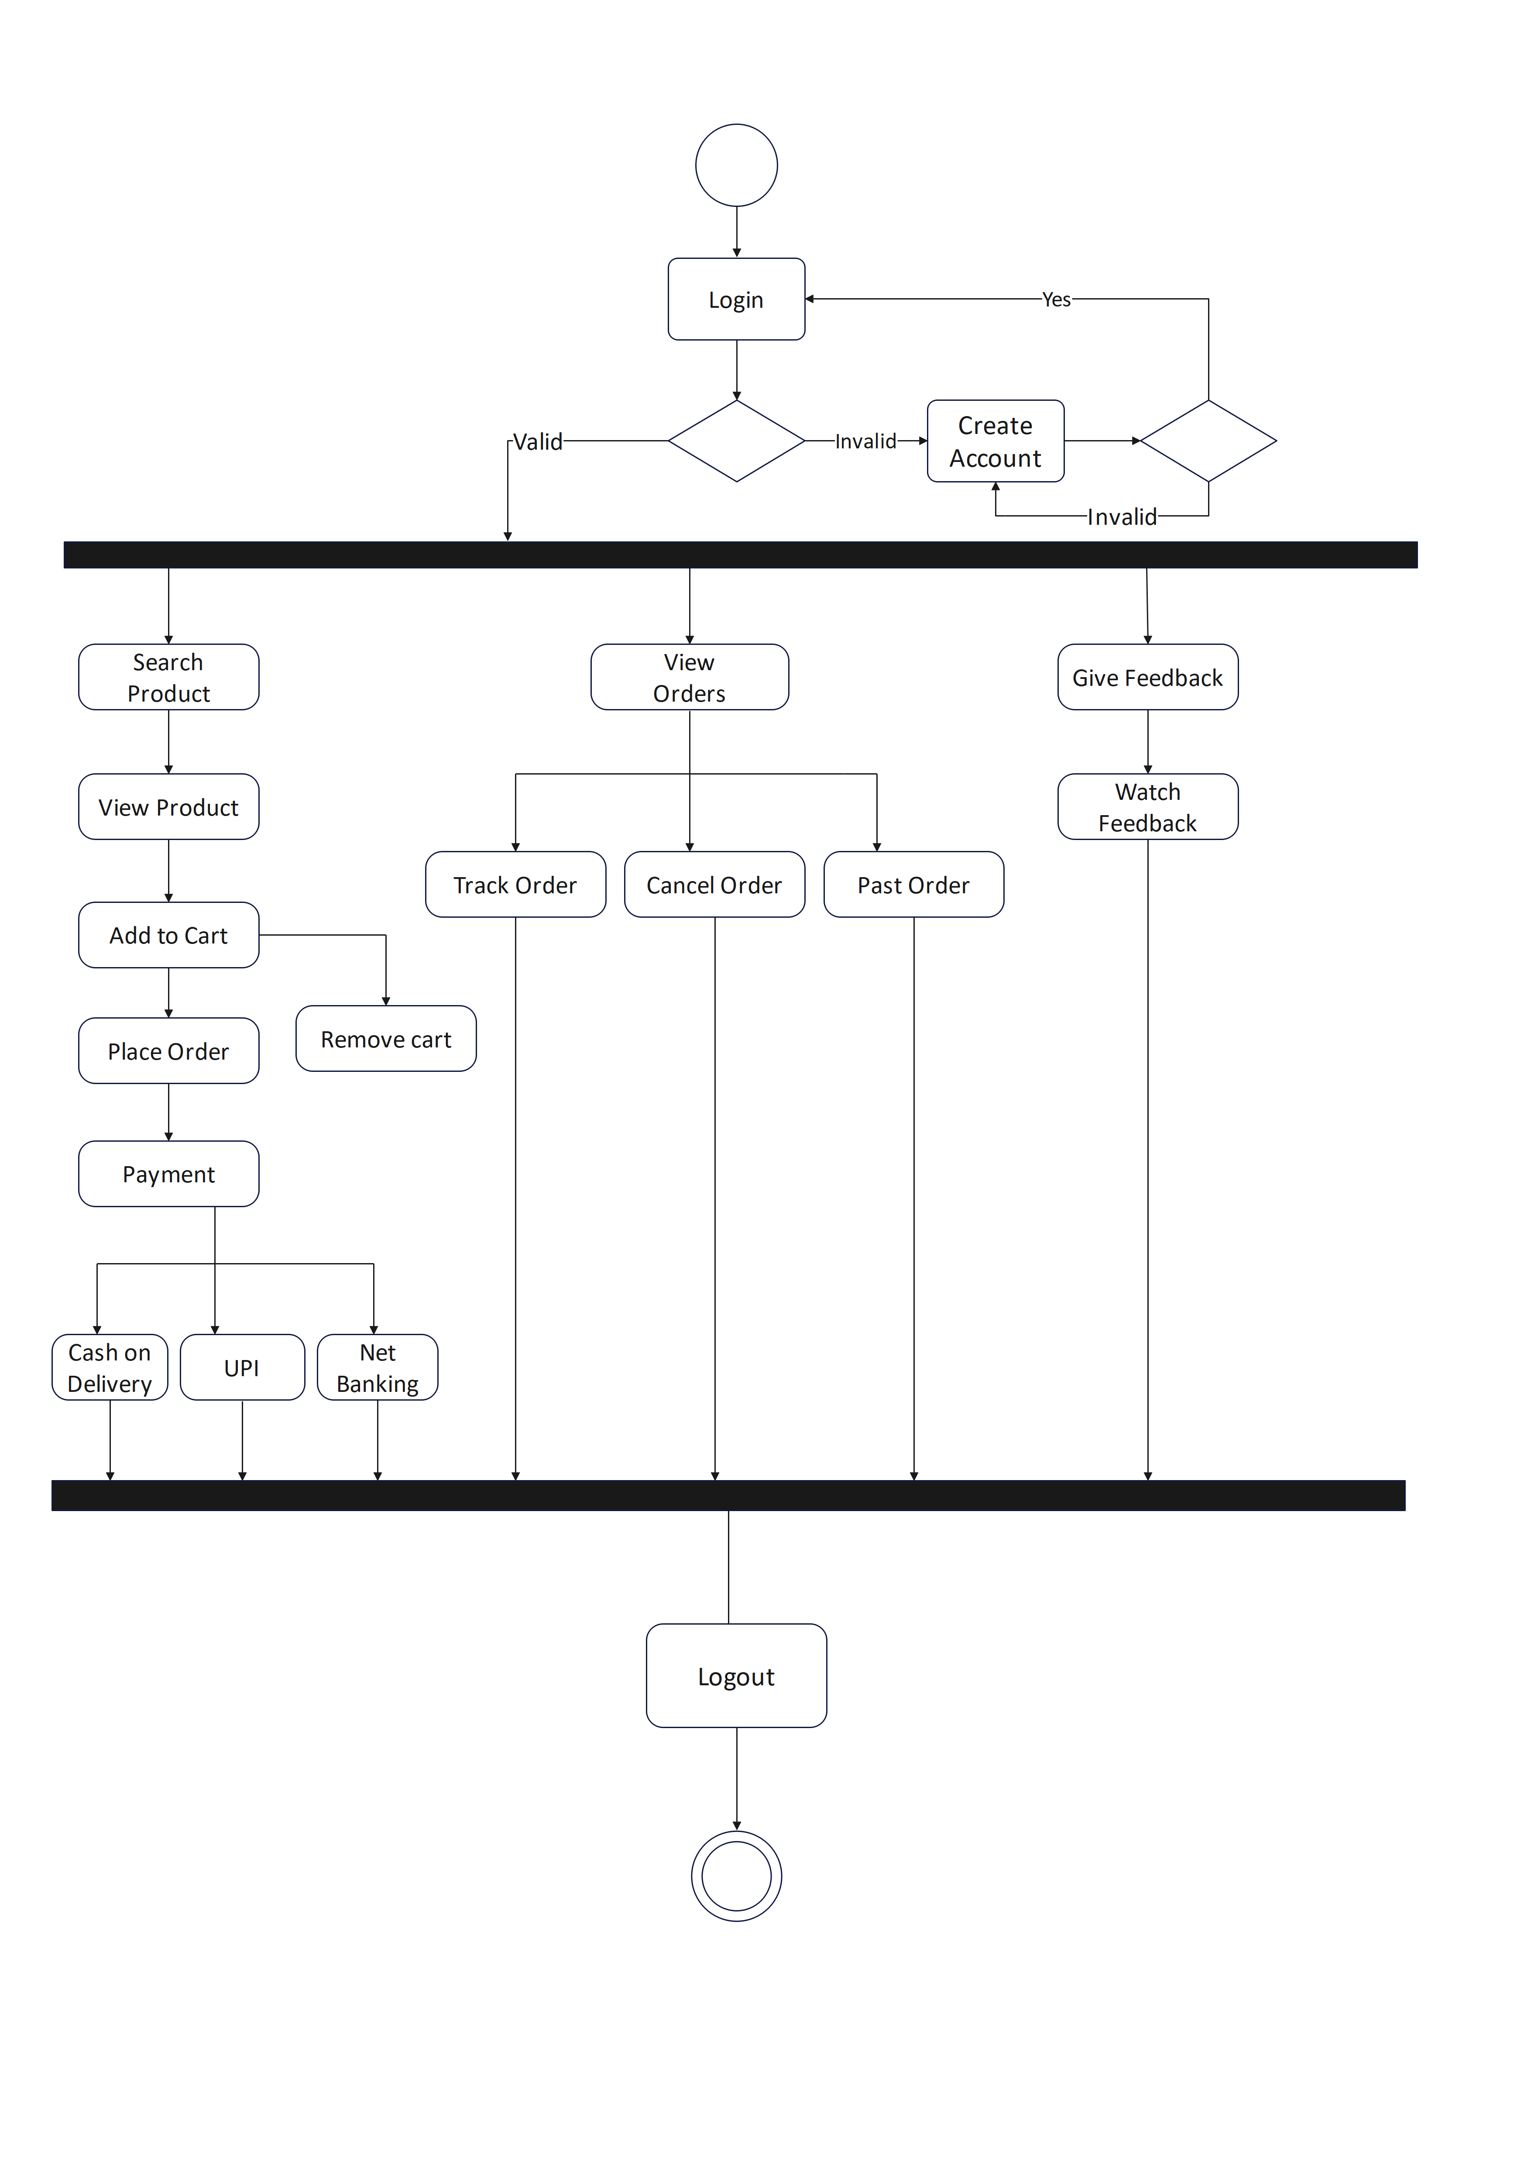
Activity User

Slide 32
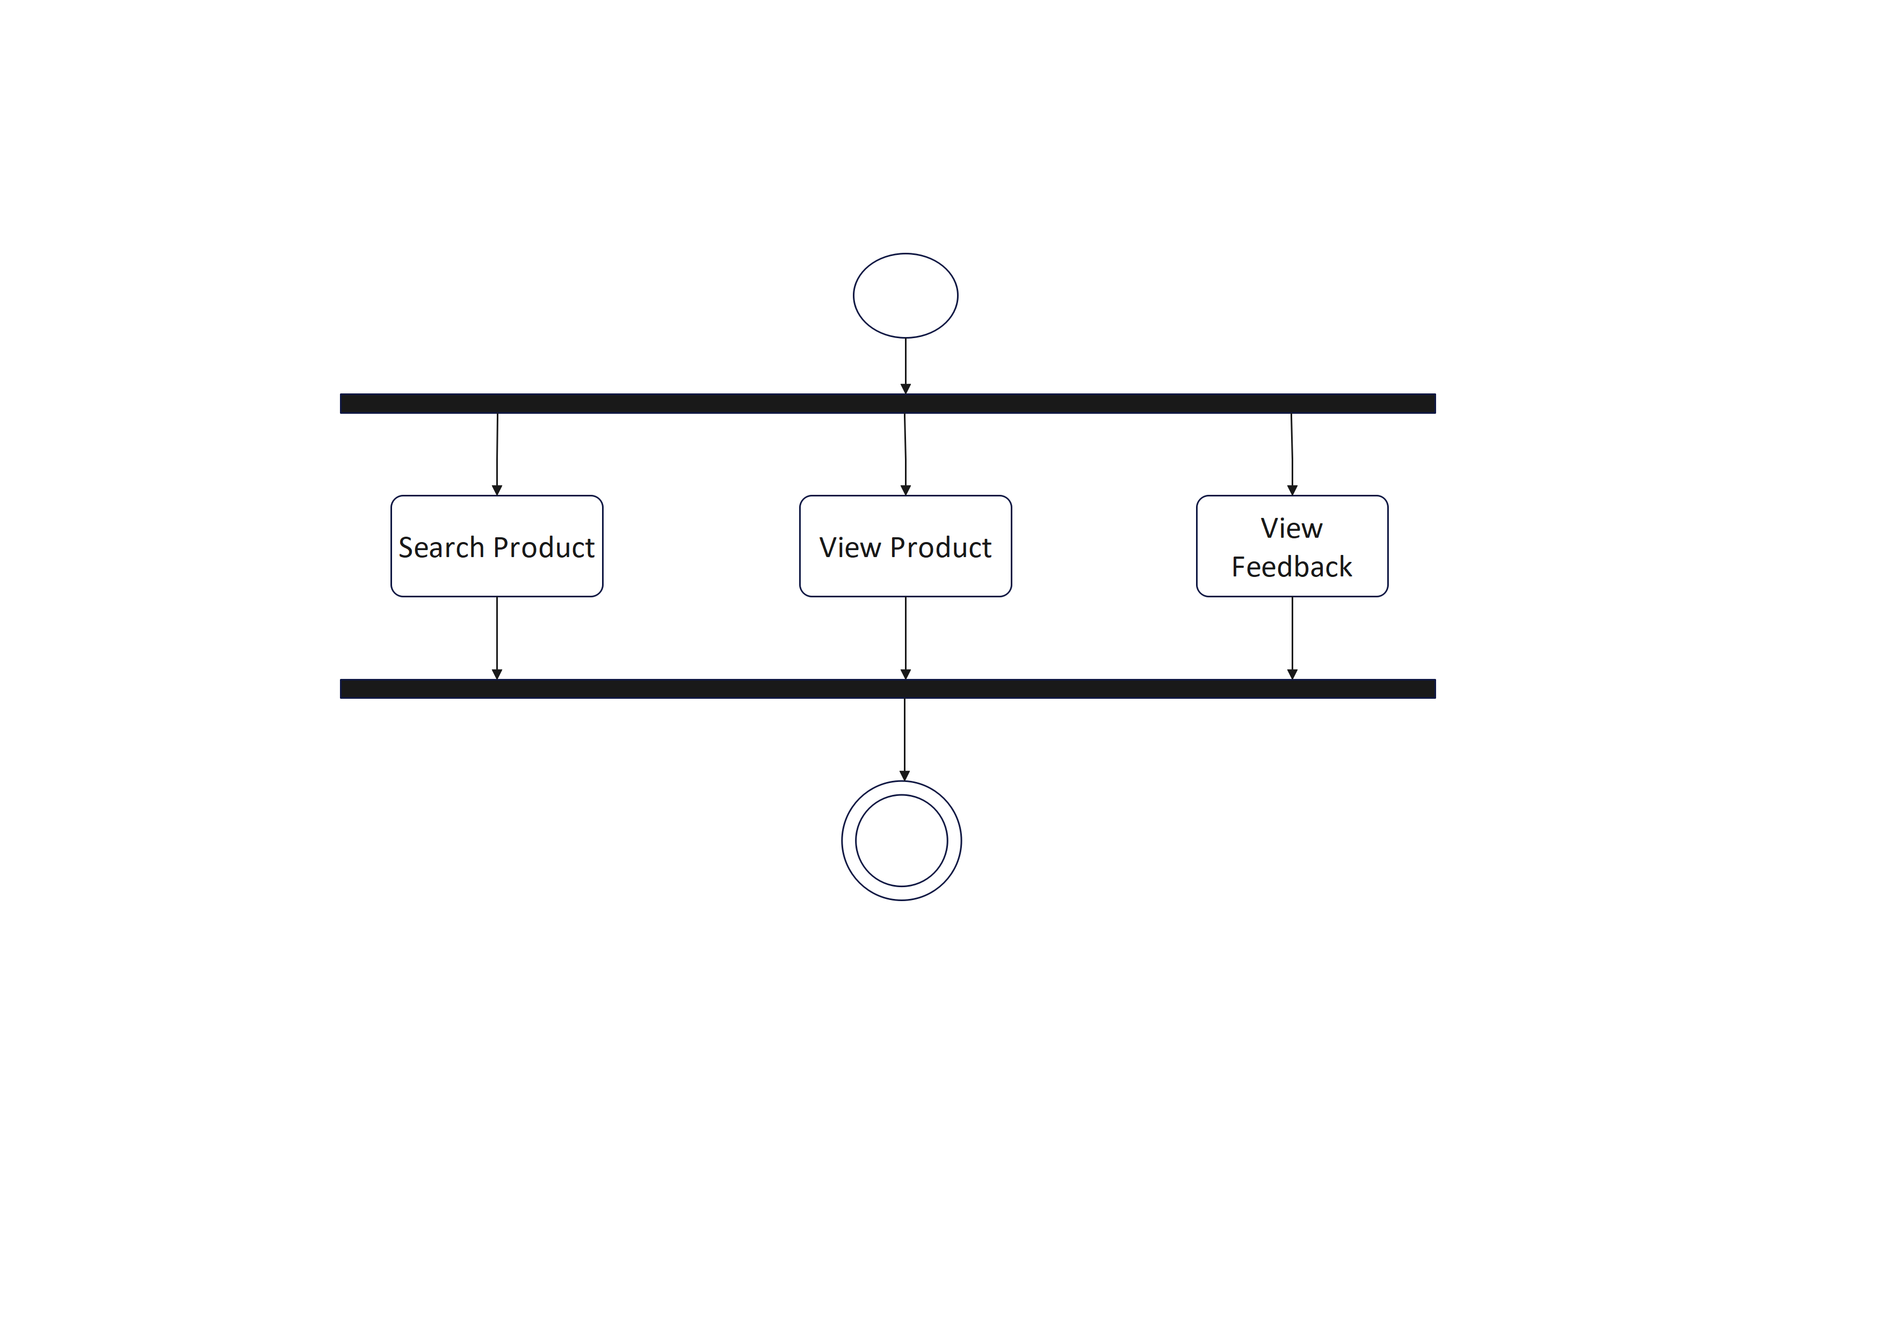
Activity Visitor

Slide 33
IV. Sequence Diagram:
▪ A sequence diagram simply depicts interaction between objects in a sequential order.
▪ A sequence diagram is an interaction diagram that shows how objects operate with one another and in what order objects. It is a construct of a message sequence chart. A sequence diagram shows object interactions arranged in time sequence.

Slide 34
 | Arrow represents and event occur between objects.
 | Rectangle represents Objects in Diagram.
 | Represents the Time occur between request and response of the object.
 | Back arrow represents response of the event to the objects.

Slide 35
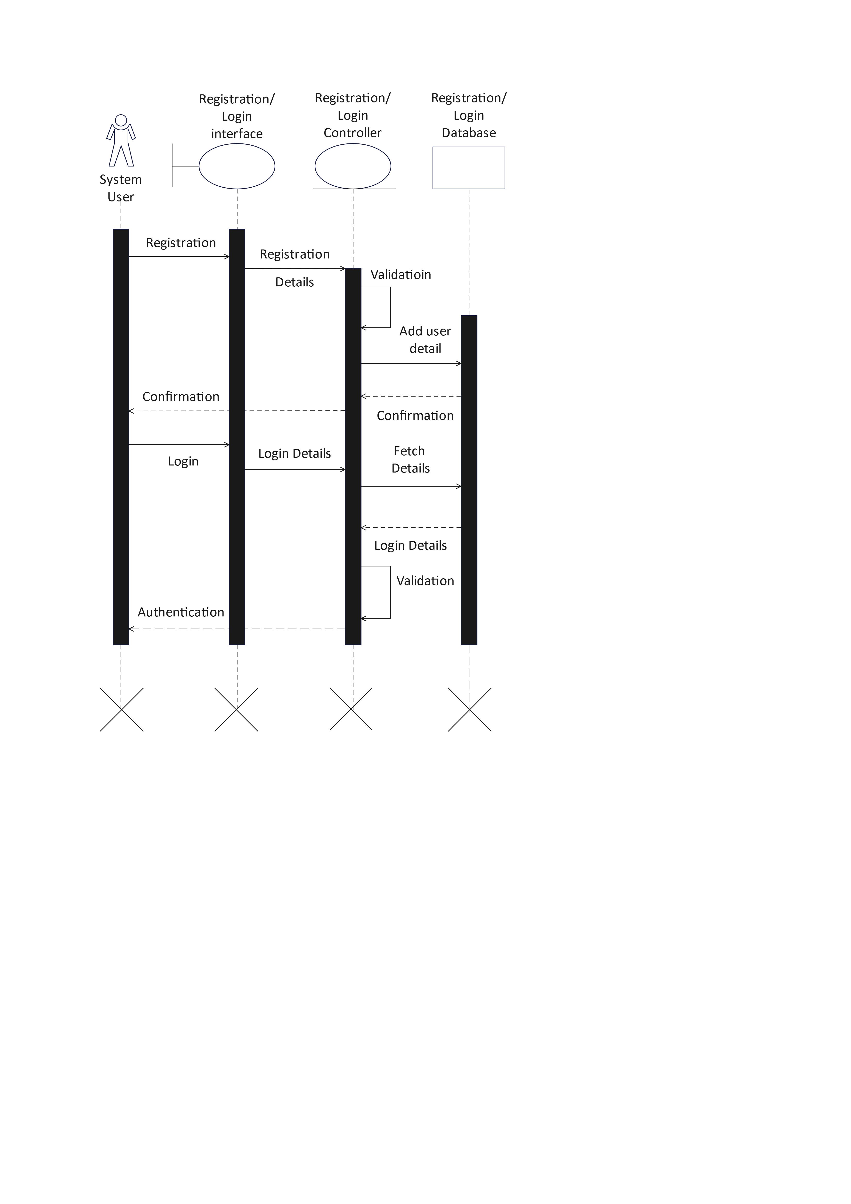
Registration & Login Sequence Diagram

Slide 36
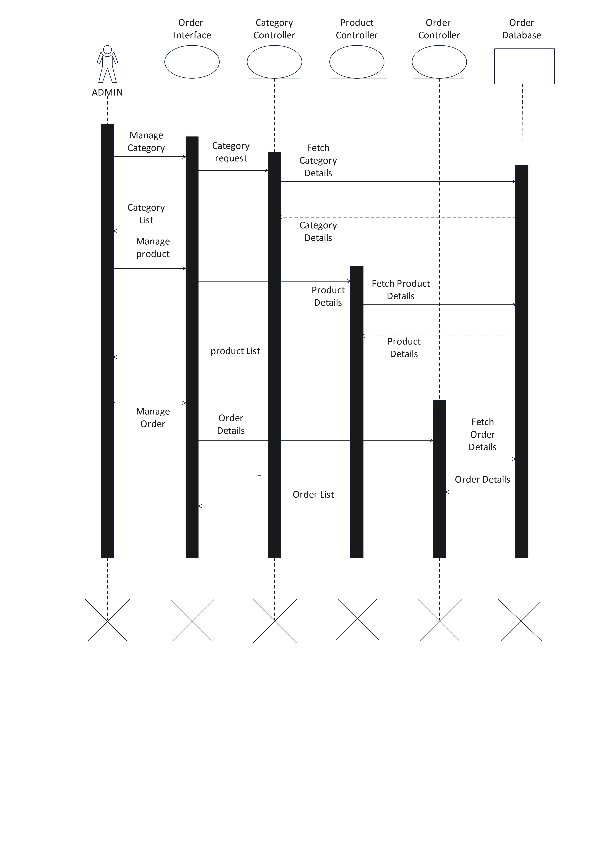
Admin Sequence Diagram

Slide 37
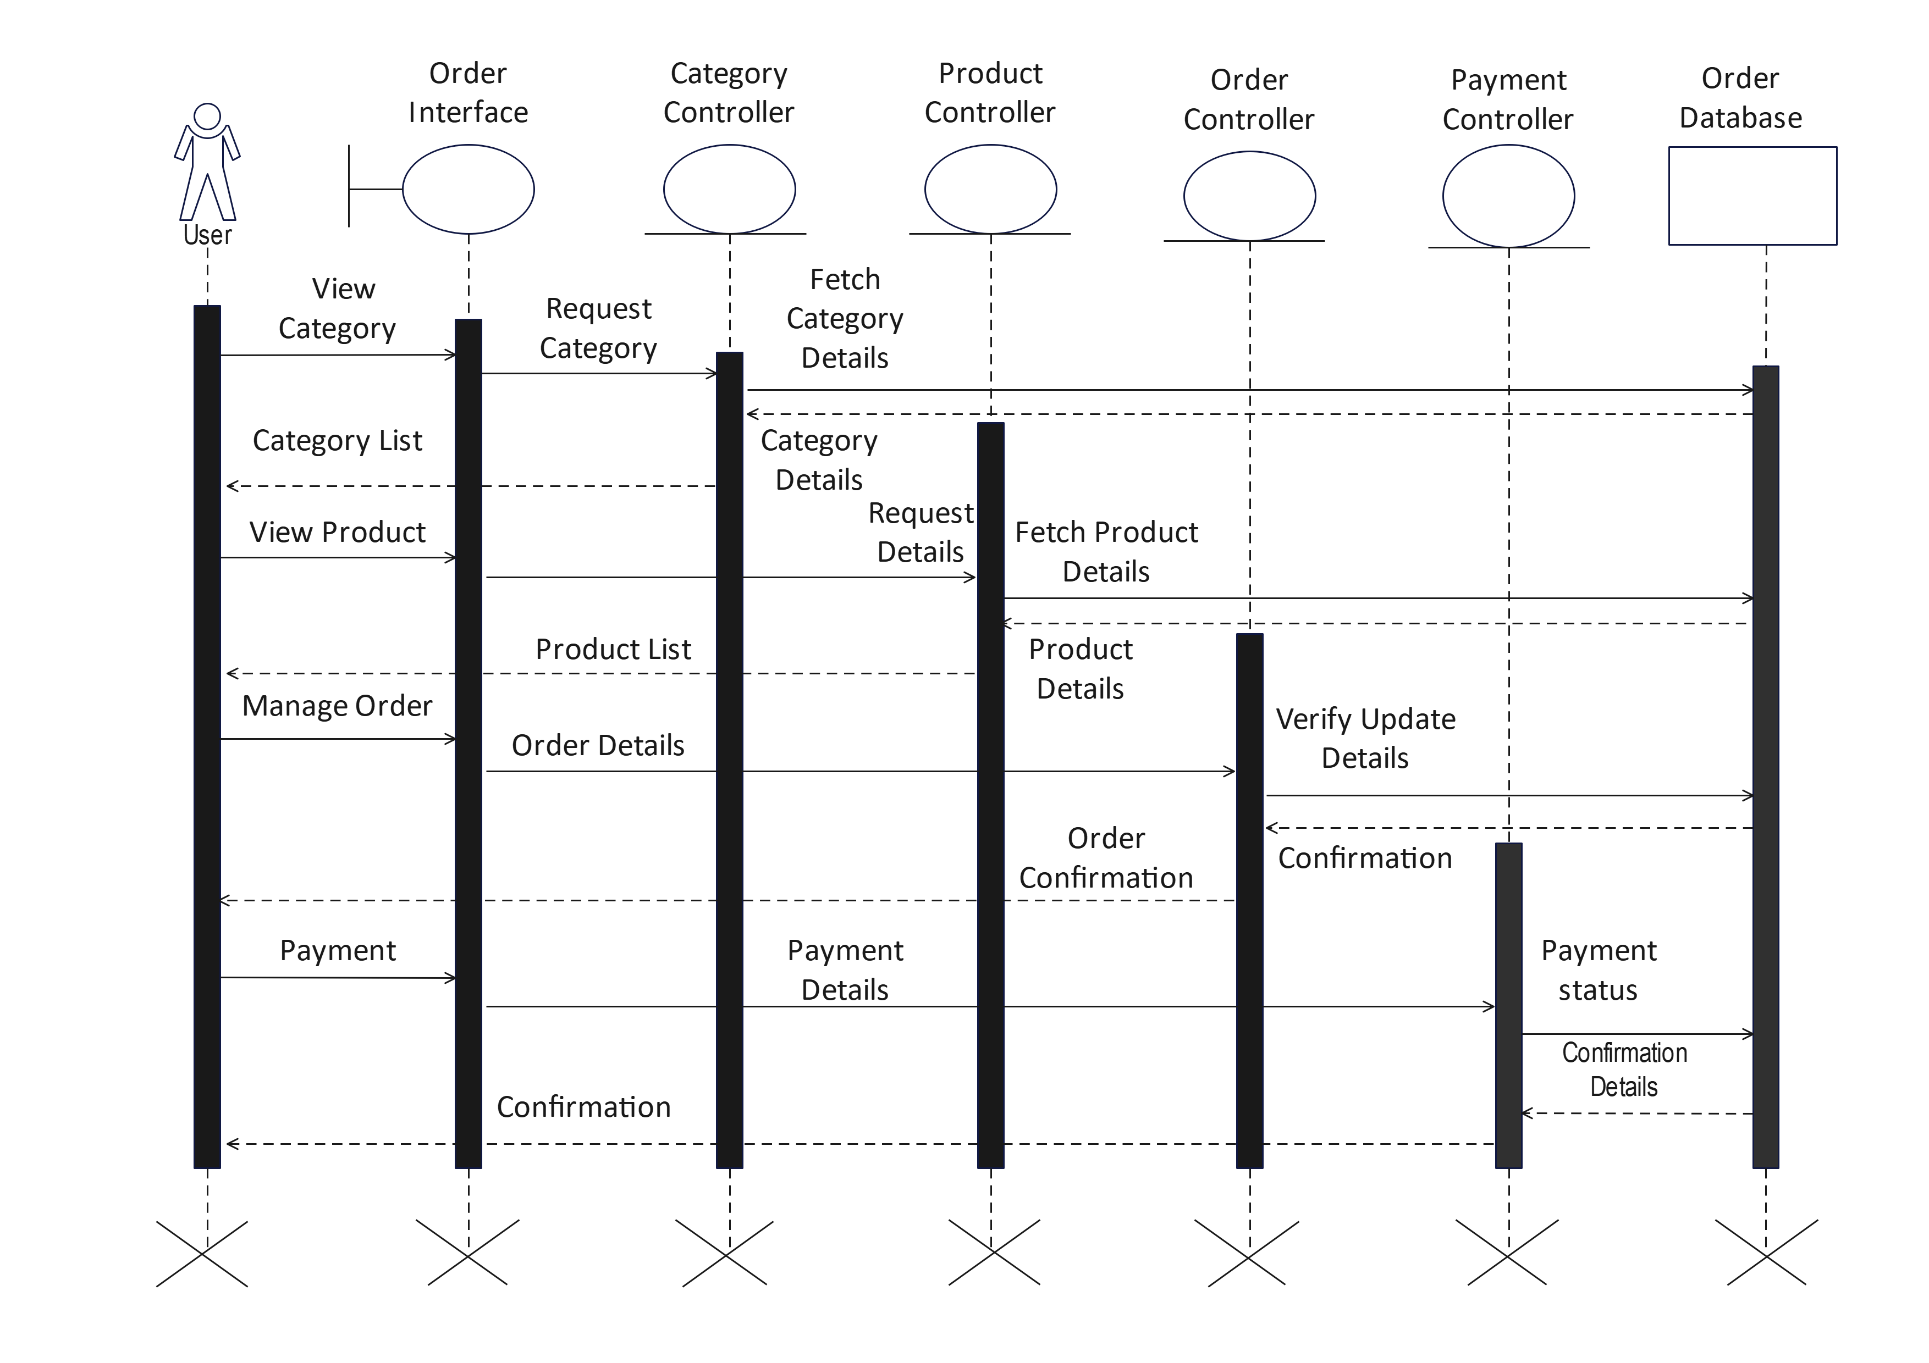
User Sequence Diagram

Slide 38
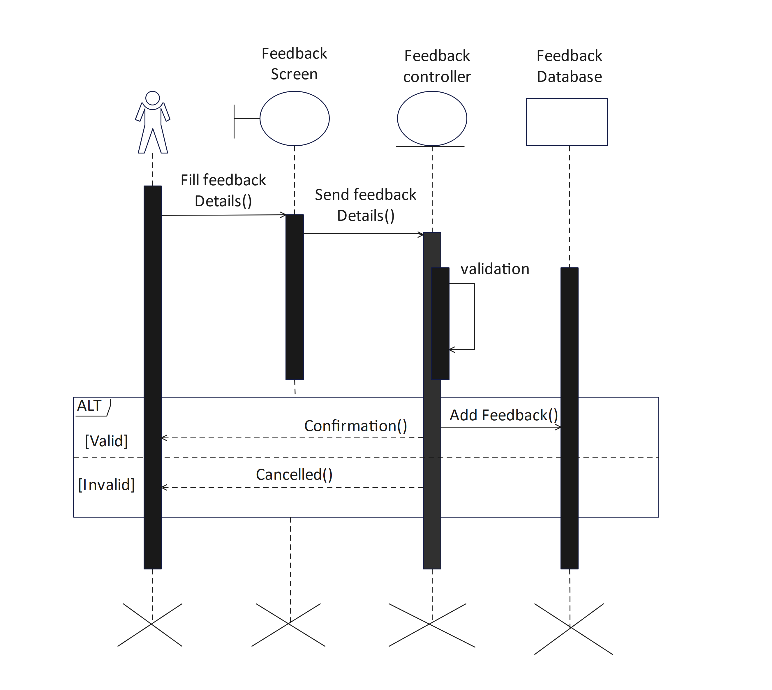
Feedback Sequence Diagram

Slide 39
System Flow Diagram:
▪ This is diagram which helps to show the actual flow of the system that is how a system is going to work and what is it’s flow, from where it is starting and what are its functionalities and how we are going to exit out from our system.
▪ A SFD (System Flow Diagram) shows what kind of information will be input to and output from the system where the data will come from and go to, and where the data will be stored. It gives the clear idea about the whole process, say it an application or a normal data flow.

Slide 40
 | Start/End
 | Arrows
 | Data
 | Process
 | Decision

Slide 41
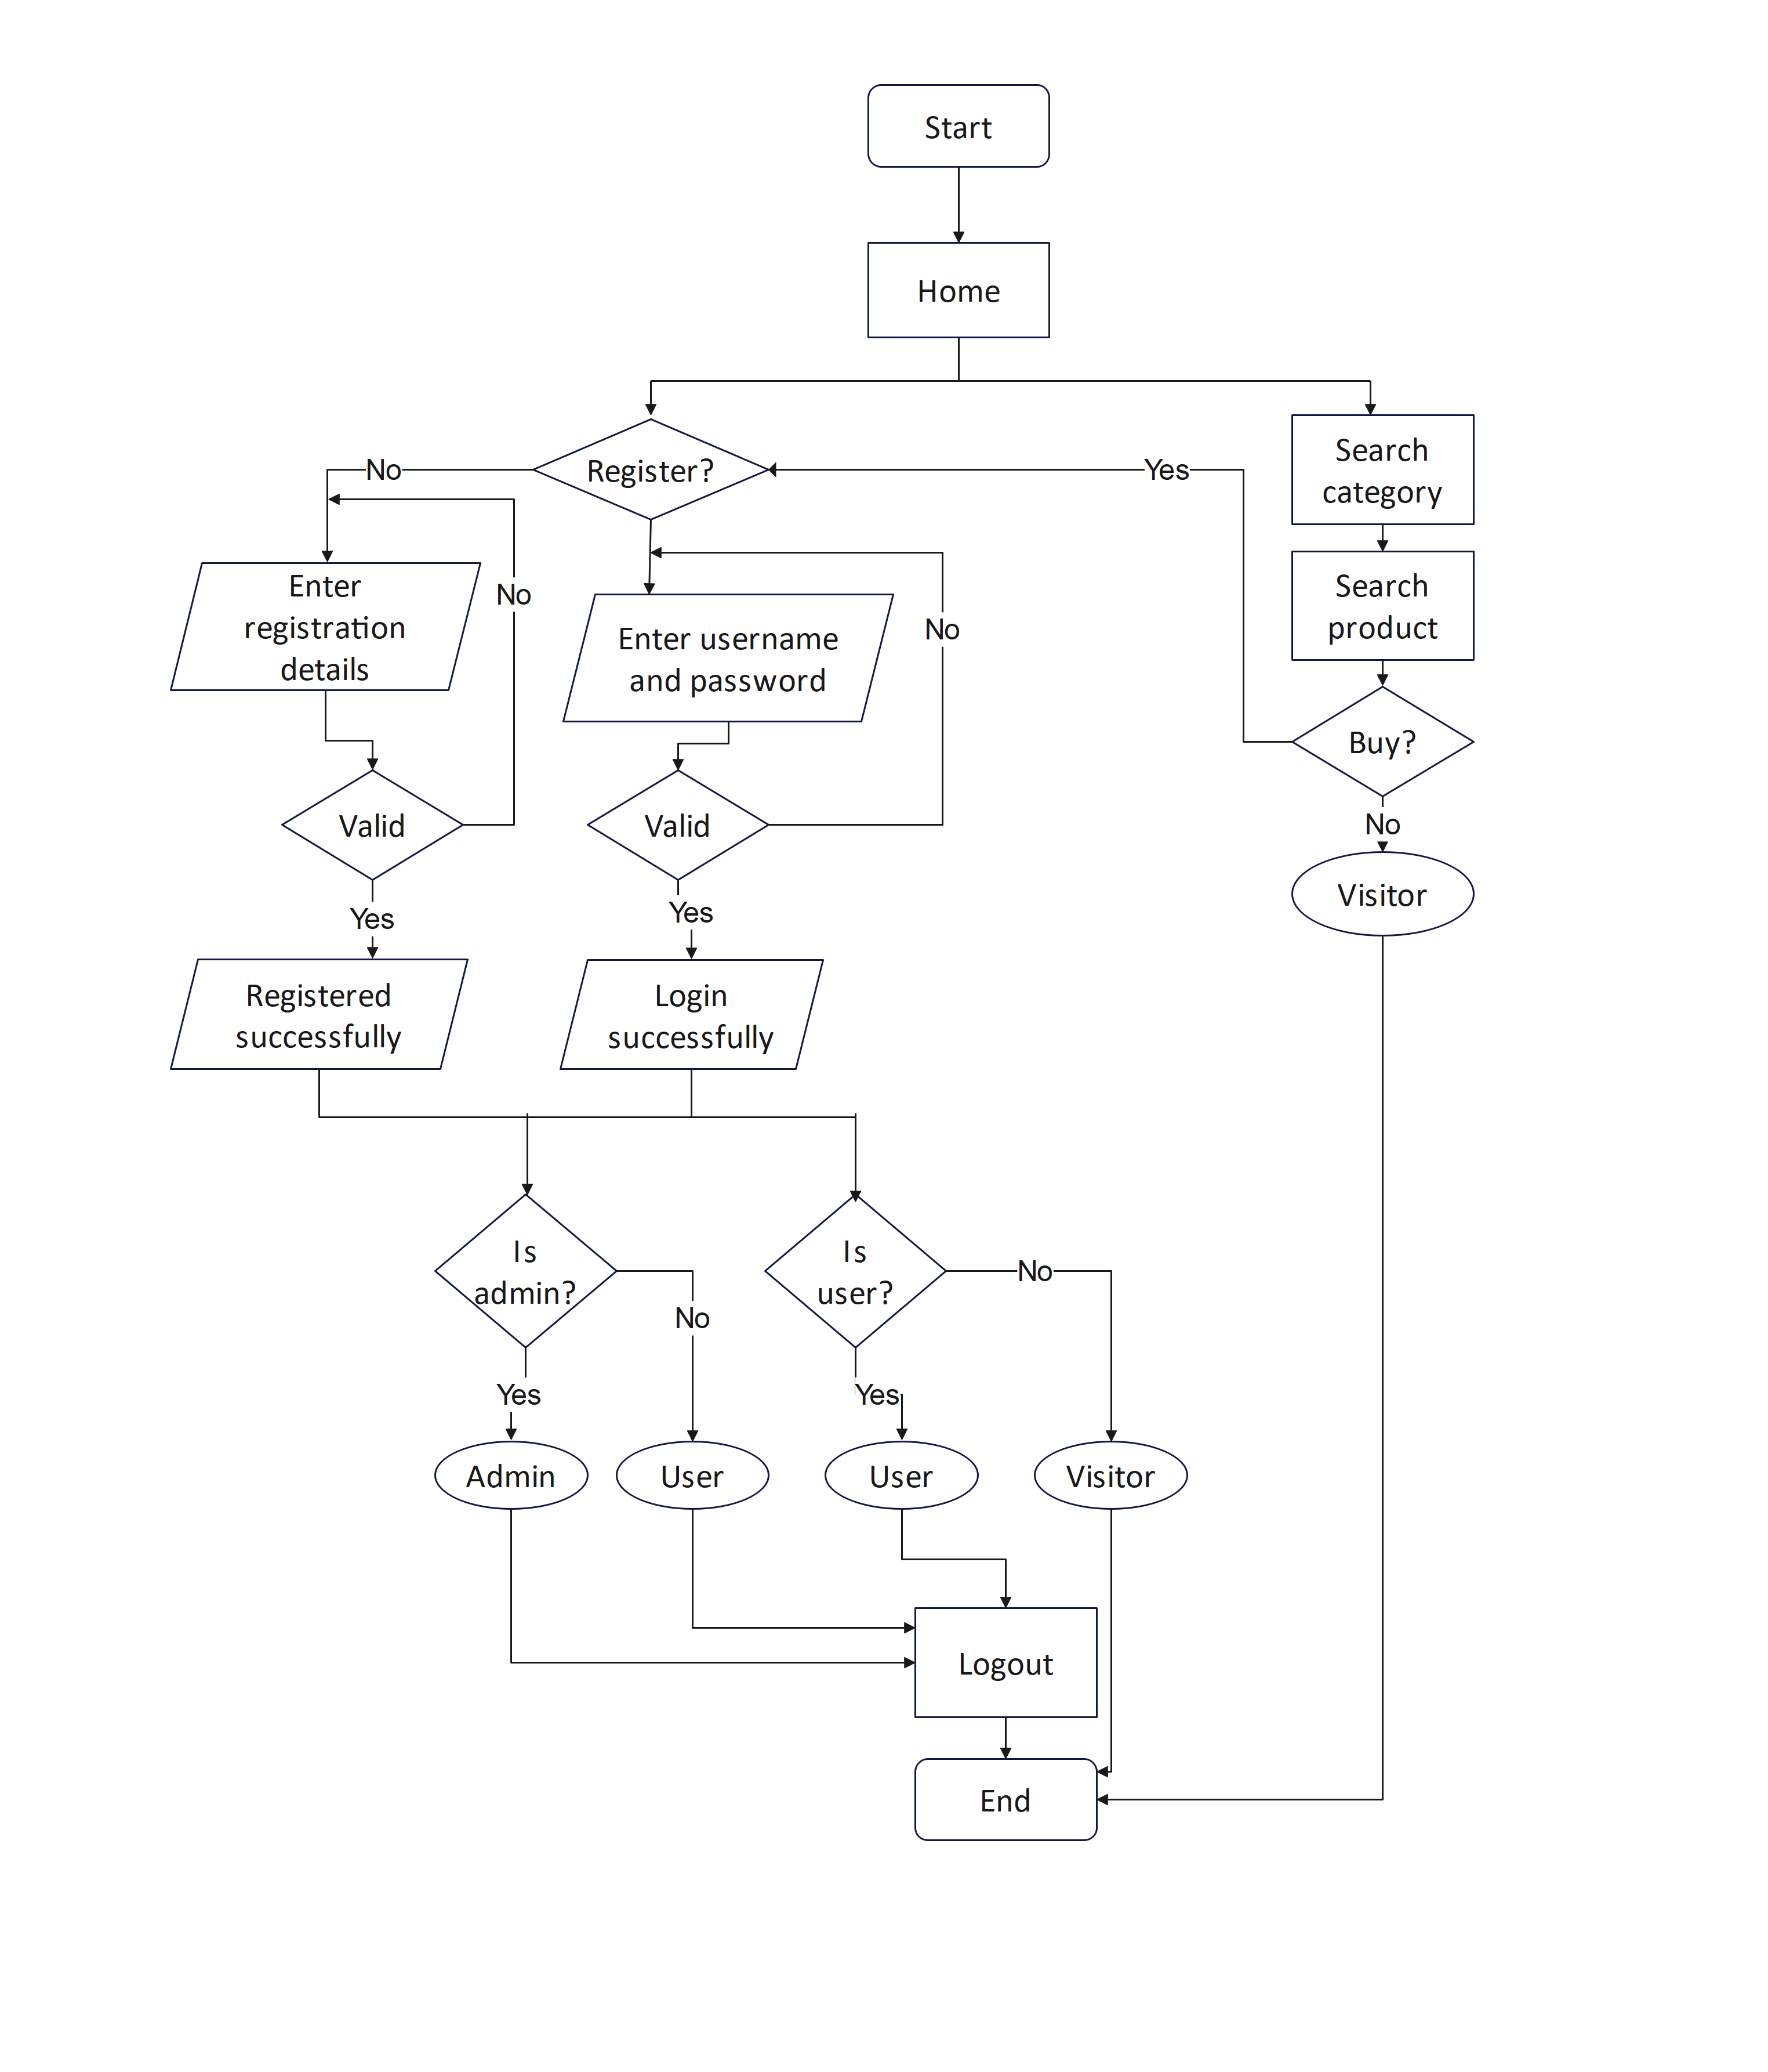

Slide 42
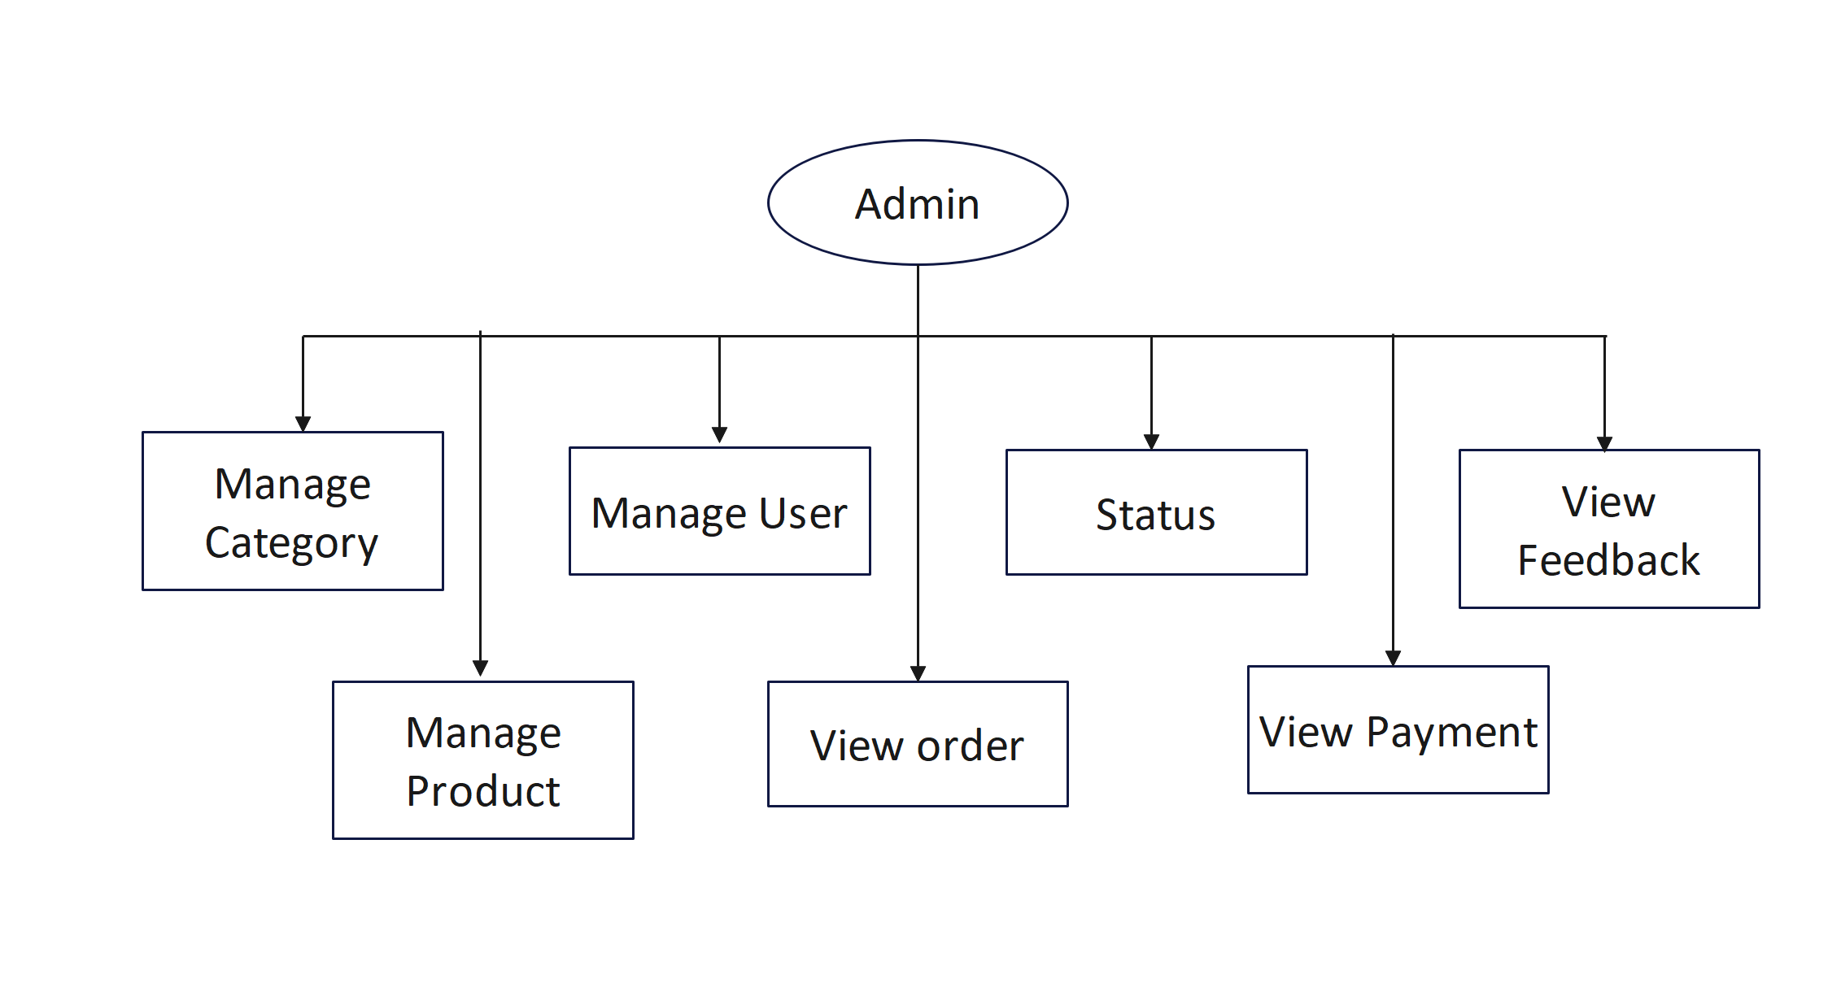
System Flow Diagram for Admin

Slide 43
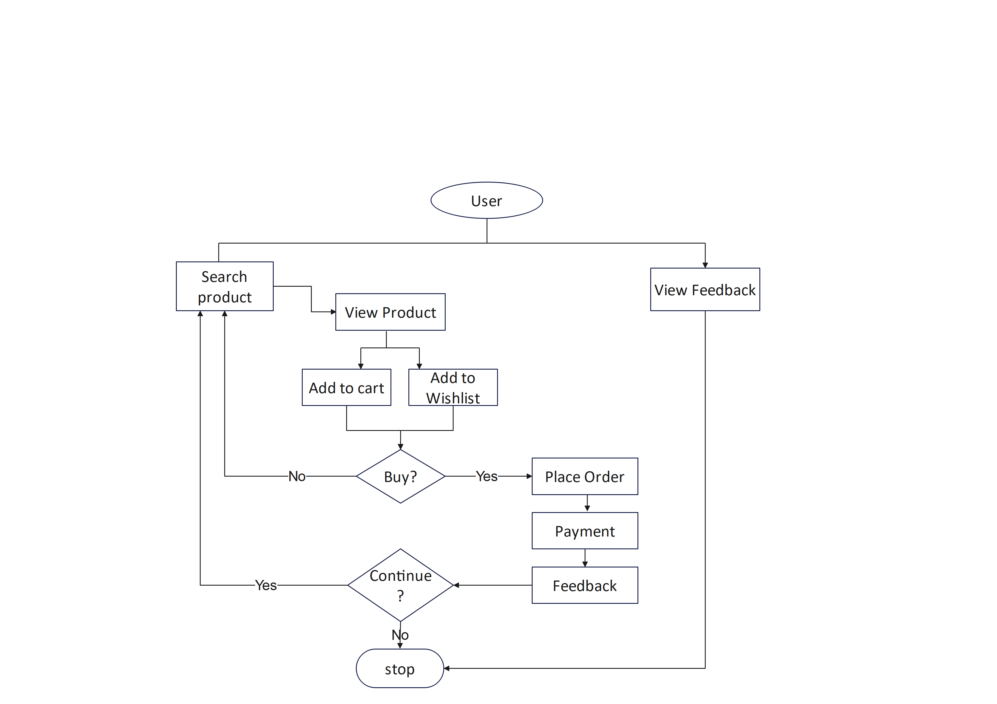
System Flow Diagram for User

Slide 44
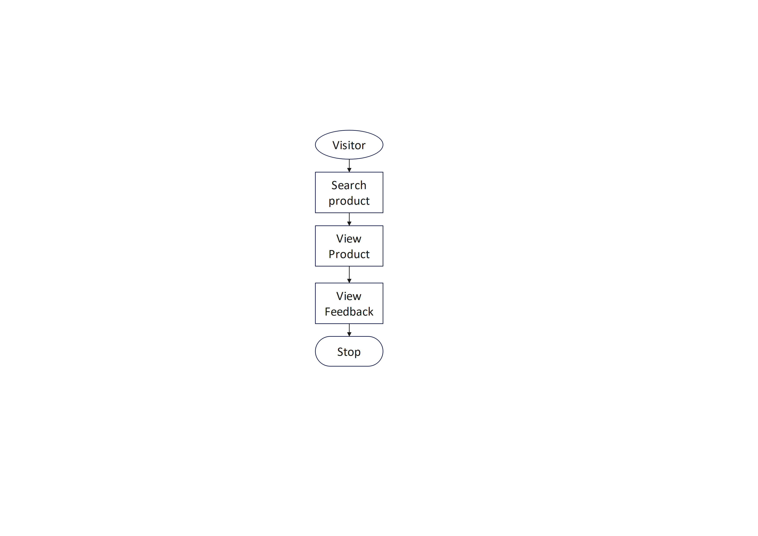
System Flow Diagram for Visitor

Slide 45
Data Dictionary: -
1. tbl_admin:
primary key: admin_id
Column name | Data type | Size | Constraint | Description
admin_id | Int | 5 | Primary key | It stores unique id of admin.
admin_name | Varchar | 15 | Not Null | It stores name of admin.
admin_email | Varchar | 30 | Not Null | It stores email of admin.
admin_password | Varchar | 10 | Unique key | It verifies password of admin.
admin_mobile | Number | 10 | Not Null | It stores Mobile number of admin.

Slide 46
2. tbl_user:
primary key: user_id
primary key: user_mobile
Column name | Data type | Size | Constraint | Description
user_id | Int | 5 | Primary key | It stores unique id of User.
user_name | Varchar | 15 | Not Null | It stores Name of user.
user_gender | Varchar | 6 | Not Null | It stores Gender of user.
user_dob | Date |  | Not Null | It stores Date of birth of user.
user_email | Varchar | 30 | Not Null | It stores email of user.
user_password | Varchar | 20 | Not Null | It stores password of user.
user_mobile | Number | 10 | Primary key | It stores mobile number of user.
user_address | varchar | 150 | Not Null | It stores address of user.

Slide 47
3. tbl_category:
primary key: category_id
Column name | Data type | Size | Constraint | Description
category_id | Int | 5 | Primary key | Category id for categories.
category_name | Varchar | 15 | Not Null | Contains name of categories.

Slide 48
4.tbl_product:
primary key: product_id foreign key: category_id
Column name | Data type | Size | Constraint | Description
product_id | Int | 5 | Primary key | It stores unique id of Product.
product_name | Varchar | 20 | Not Null | It stores Name of Product.
product_details | Text |  | Not Null | It stores Details of Product.
product_photo | Varchar | 80 | Not Null | It stores Photo of Product.
product_price | Float | 5,2 | Not Null | It stores Price of Product.
category_id | Int | 5 | Foreign key | It stores Category id of Product.
product_quantity | Int | 20 | Not Null | It stores product Quantity.

Slide 49
5. tbl_wishlist:
primary key: wishlist_id
foreign key: user_id
foreign key: product_id
Column name | Data type | Size | Constraint | Description
wishlist_id | Int | 5 | Primary key | It stores wishlist id.
user_id | Int | 5 | Foreign key | It stores user id.
product_id | Int | 5 | Foreign key | It stores product id.

Slide 50
6. tbl_cart:
primary key:cart_id
foreign key:product_id
foreign key:user_id
Column name | Data type | Size | Constraint | Description
cart_id | Int | 5 | Primary key | It stores Unique cart id.
product_id | Int | 5 | foreign key | It stores Id of product.
quantity | Int | 20 | Not Null | It stores quantity of cart.
price | Float | 5,2 | Not Null | It stores Price of Cart.
user_id | Varchar | 2 | foreign key | It stores user id.

Slide 51
7. tbl_ordermaster:
primary key:order_id
foreign key:user_id
Column name | Data type | Size | Constraint | Description
order_id | Int | 5 | Primary key | It stores unique id of Order.
ordermaster_date | Date |  | Not Null | It stores Order date of order.
ordermaster_status | Varchar | 20 | Not Null | It stores order Status.
user_id | Int | 5 | Foreign key | It store User id.

Slide 52
8. tbl_orderdetail:
primary key:orderdetail_id
foreign key:order_id
foreign key:product_id
Column name | Data type | Size | Constraint | Description
orderdetail_id | Int | 5 | Primary key | It stores detail of order.
order_id | Int | 5 | Foreign key | It stores Order id.
product_id | Int | 5 | Foreign key | It stores id of Product.
product_price | Float | 5,2 | Not Null | It stores Price of orderdetail.
Orderdetail_quantity | Int | 20 | Not Null | It stores quantity.

Slide 53
9. tbl_shipping:
primary key: shipping_id
foreign key: user_mobile
foreign key:order_id
Column name | Data type | Size | Constraint | Description
shipping_id | Int | 5 | primary key | It store shipping id.
user_mobile | Number | 10 | Foreign key | It stores mobile number of user.
shipping_address | Text |  | Not Null | It stores address of Shipping.
shipping_name | Varchar | 25 | primary key | It stores name of Shipping.
order_id | Int | 5 | Foreign key | It stores unique id of Order.
shipping_date | date |  | Not Null | It stores date of Shipping.

Slide 54
10. tbl_payment:
primary key: payment_id
foreign key: user_id
foreign key: order_id
Column name | Data type | Size | Constraint | Description
payment_id | Int | 5 | Primary key | It stores unique id of Payment.
user_id | Int | 5 | Foreign key | It stores unique id of User.
payment_method | Varchar | 30 | Not Null | It stores payment method.
payment_amount | Float | 20 | Not Null | It stores total amount to be paid.
order_id | Int | 5 | Foreign key | It stores Order id.

Slide 55
11. tbl_feedback:
primary key: feedback_id
foreign key: user_id
foreign key: product_id
Column name | Data type | Size | Constraint | Description
feedback_id | Int | 5 | Primary key | It stores unique id of Feedback.
feedback_date | Date |  | Not Null | It stores feedback date.
user_id | Int | 5 | Foreign key | It stores user id.
feedback_details | Text |  | Not Null | It stores feedback description given by user.
product_id | Int | 5 | Foreign key | It stores product id.

Slide 56
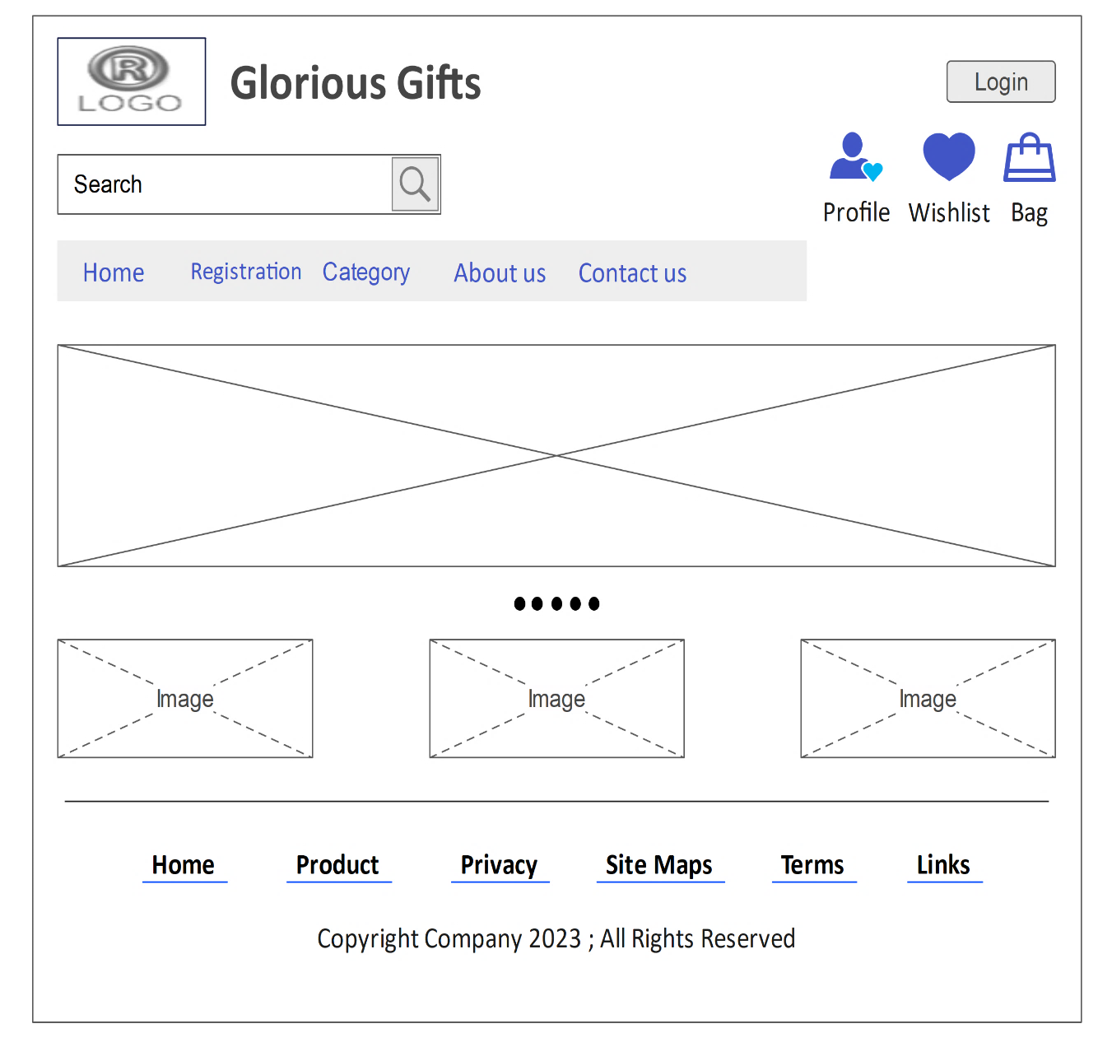
❑ User Interface:
1. Home Page

Slide 57
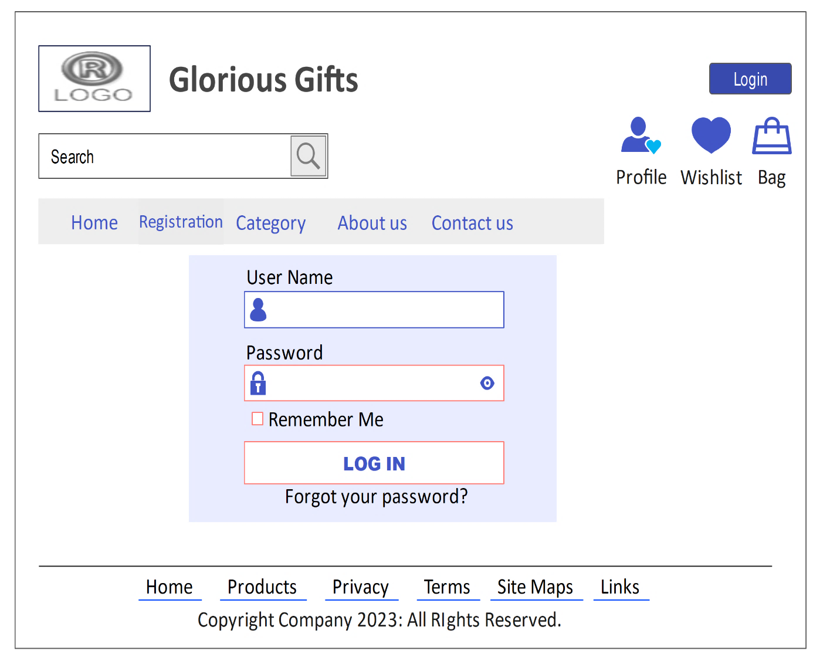
2. Login

Slide 58
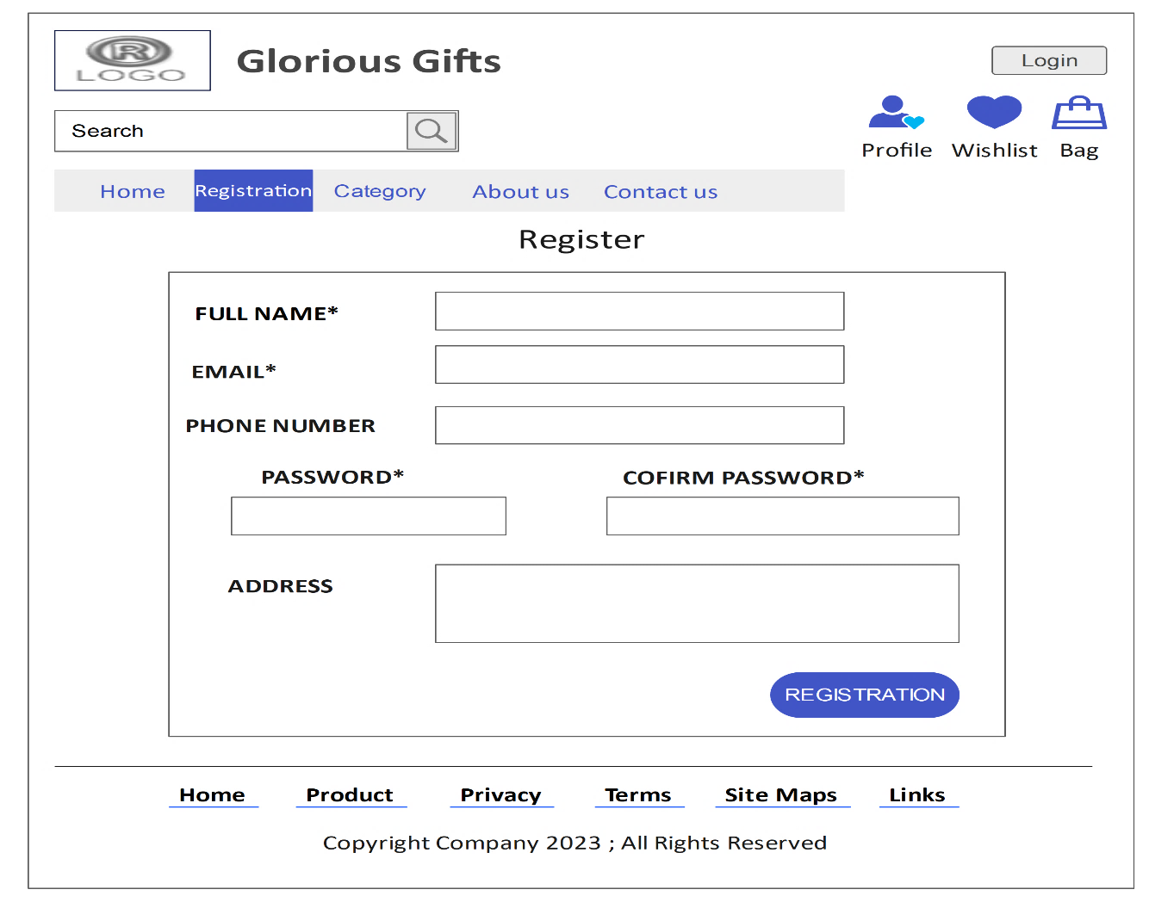
3. Registration

Slide 59
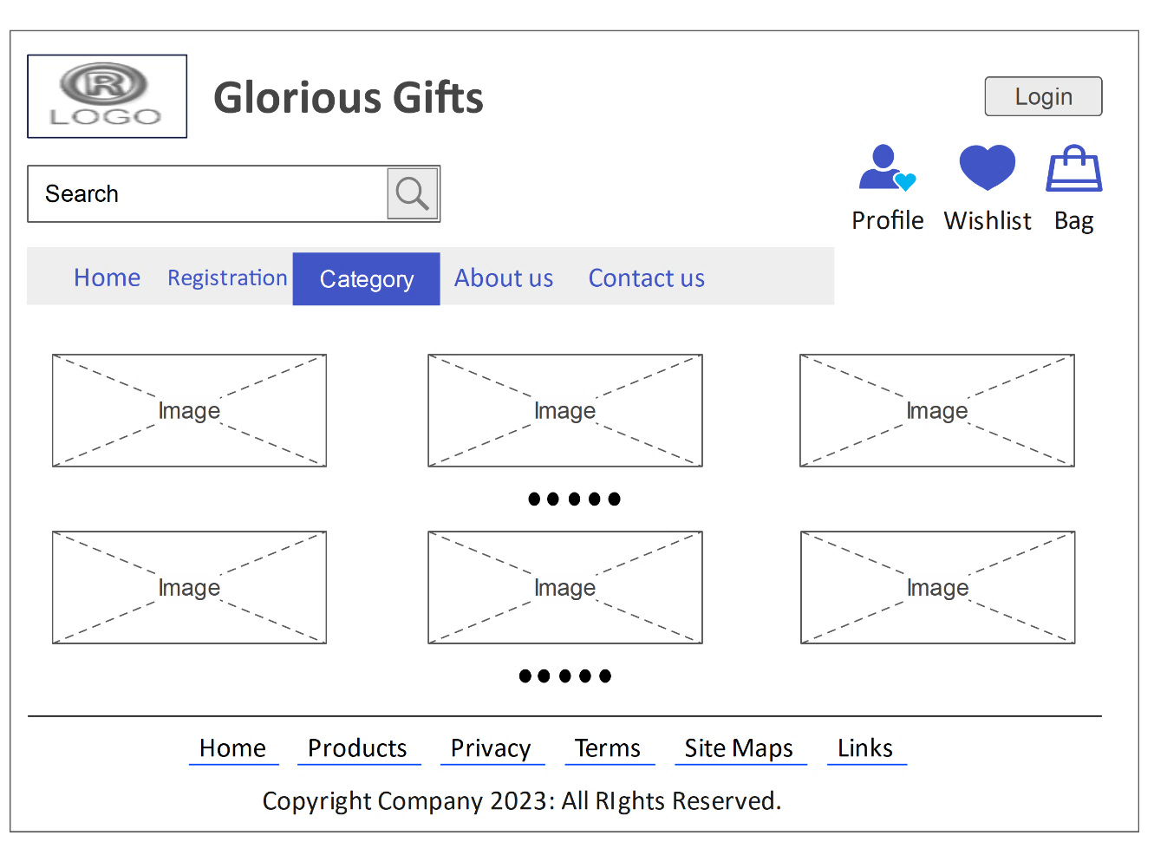
4. Category

Slide 60
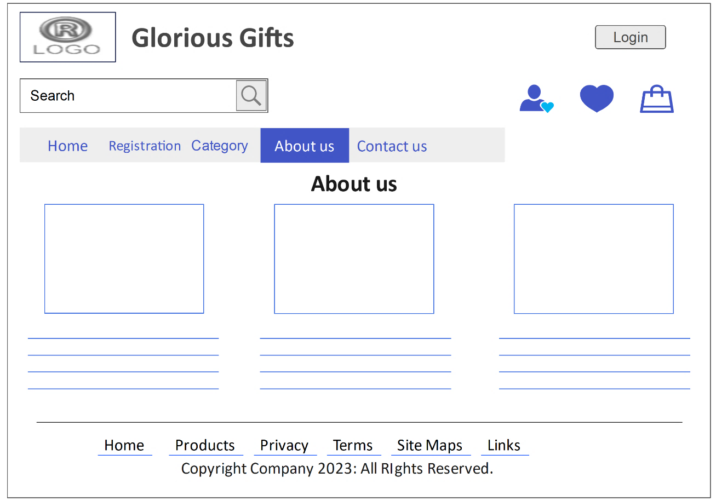
5. About us

Slide 61
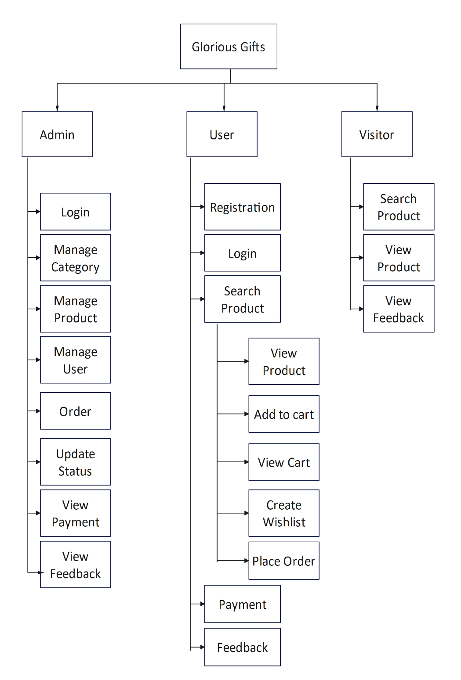
System Naviagtion: -

Slide 62
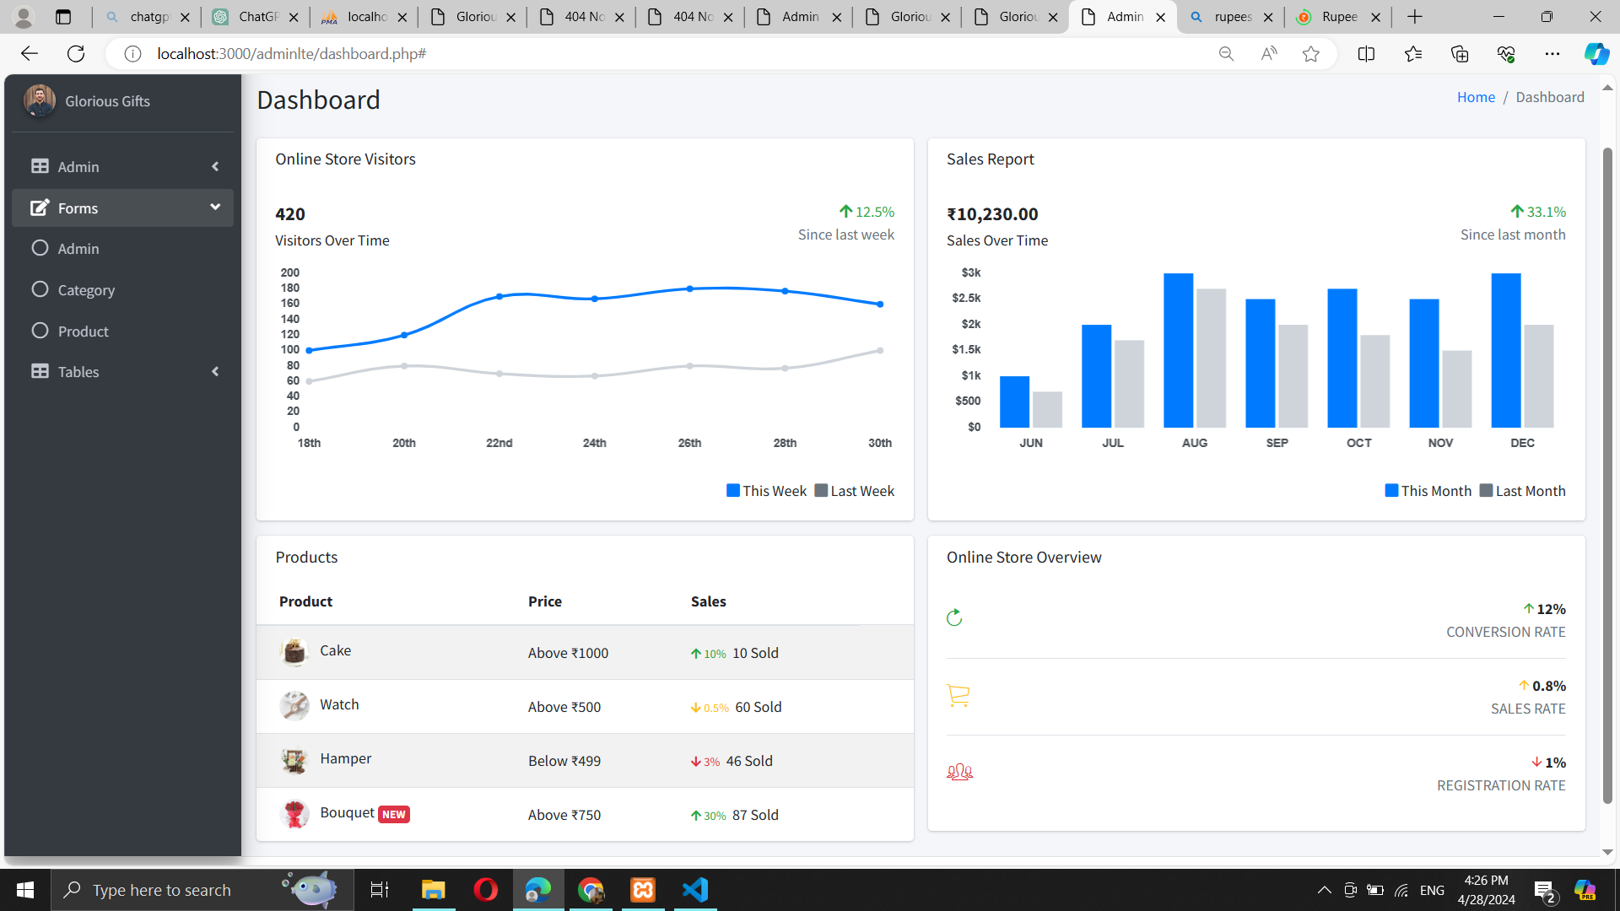
Admin panel:
Home Page

Slide 63
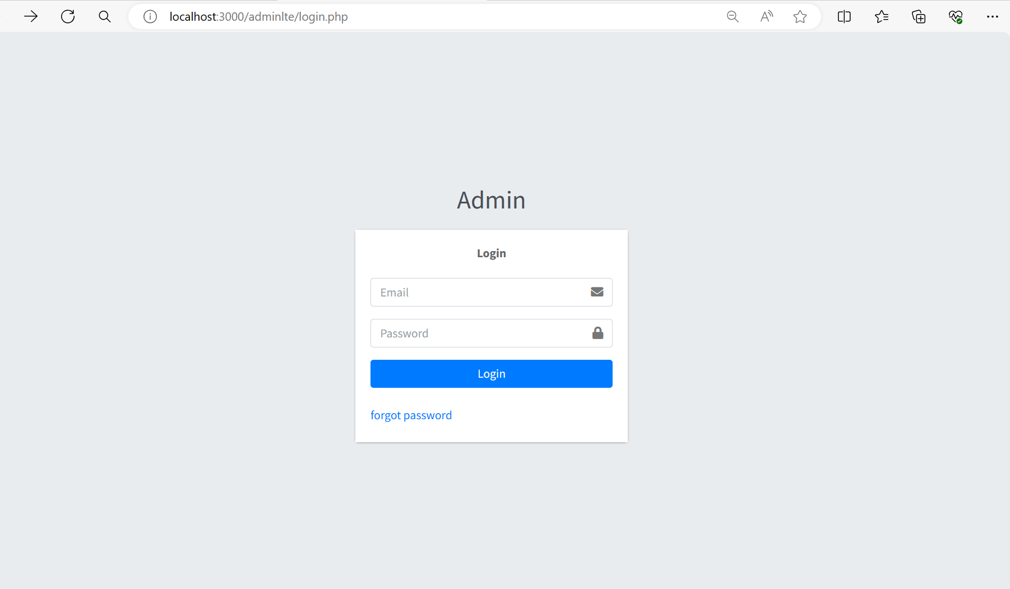
Login:

Slide 64
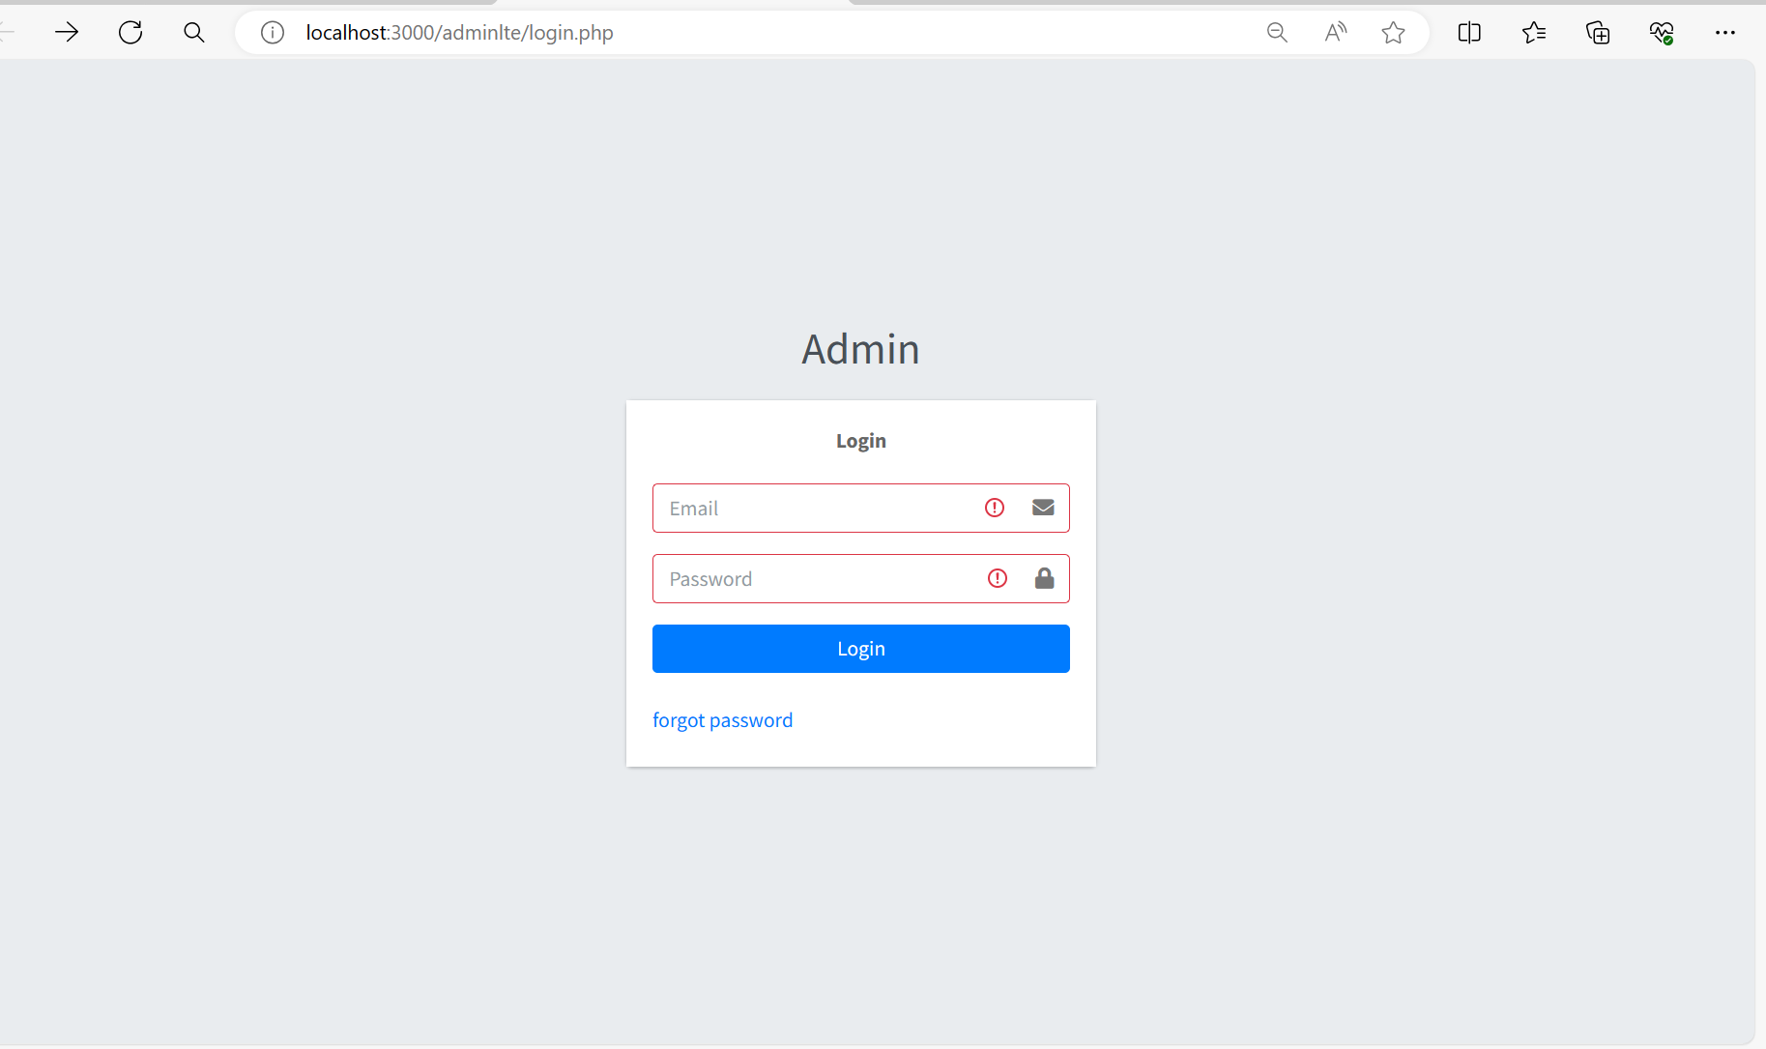
Login with validation:

Slide 65

Login with Data:

Slide 66
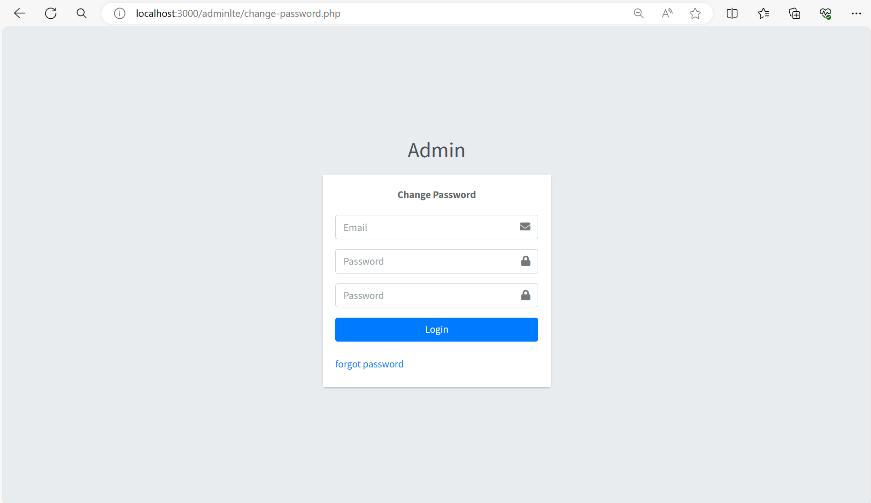
Change Password:

Slide 67
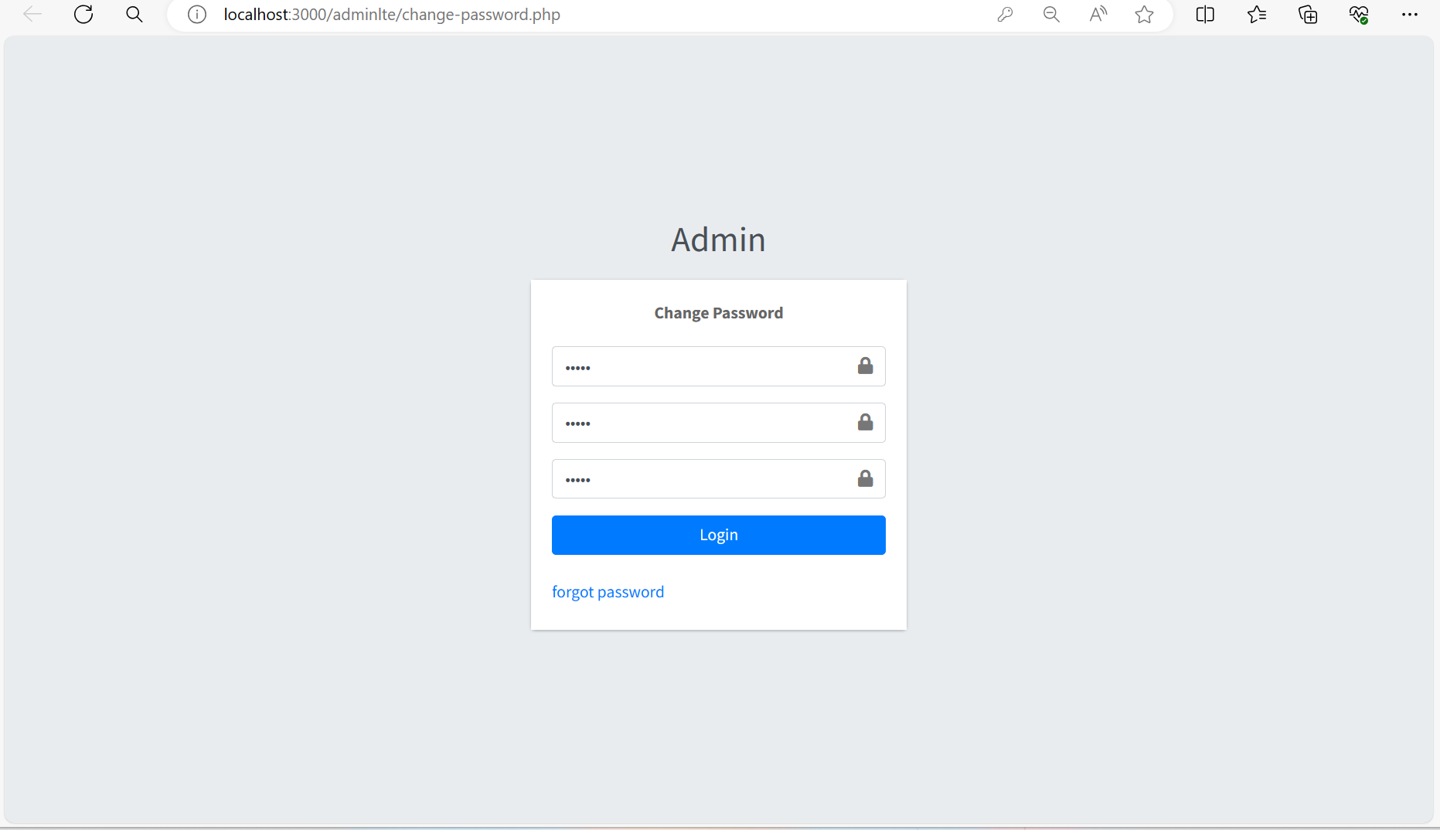
Change password with Data:

Slide 68
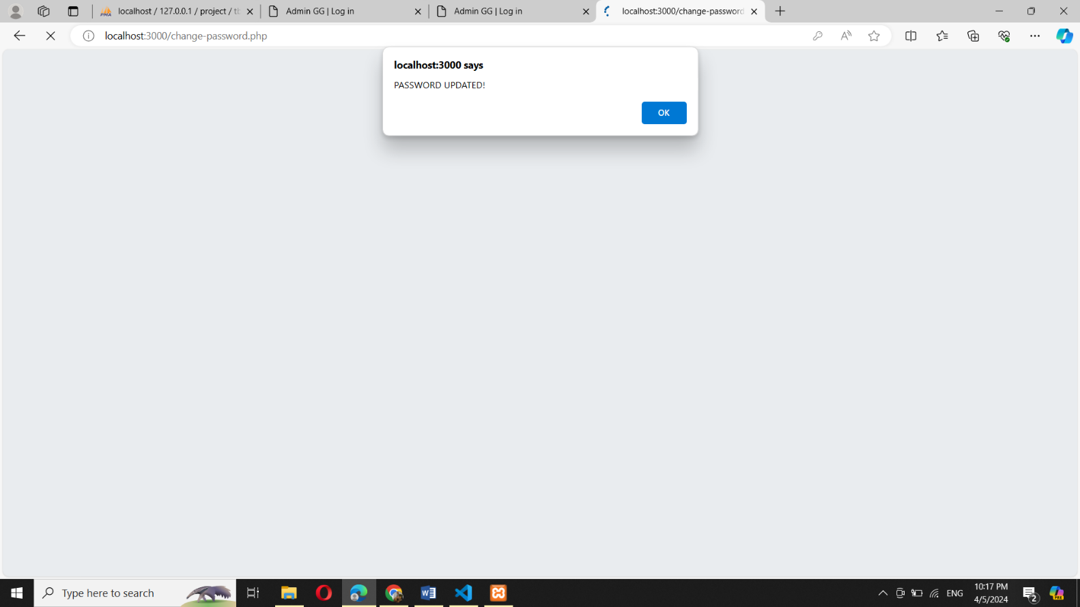
Password Changed:

Slide 69
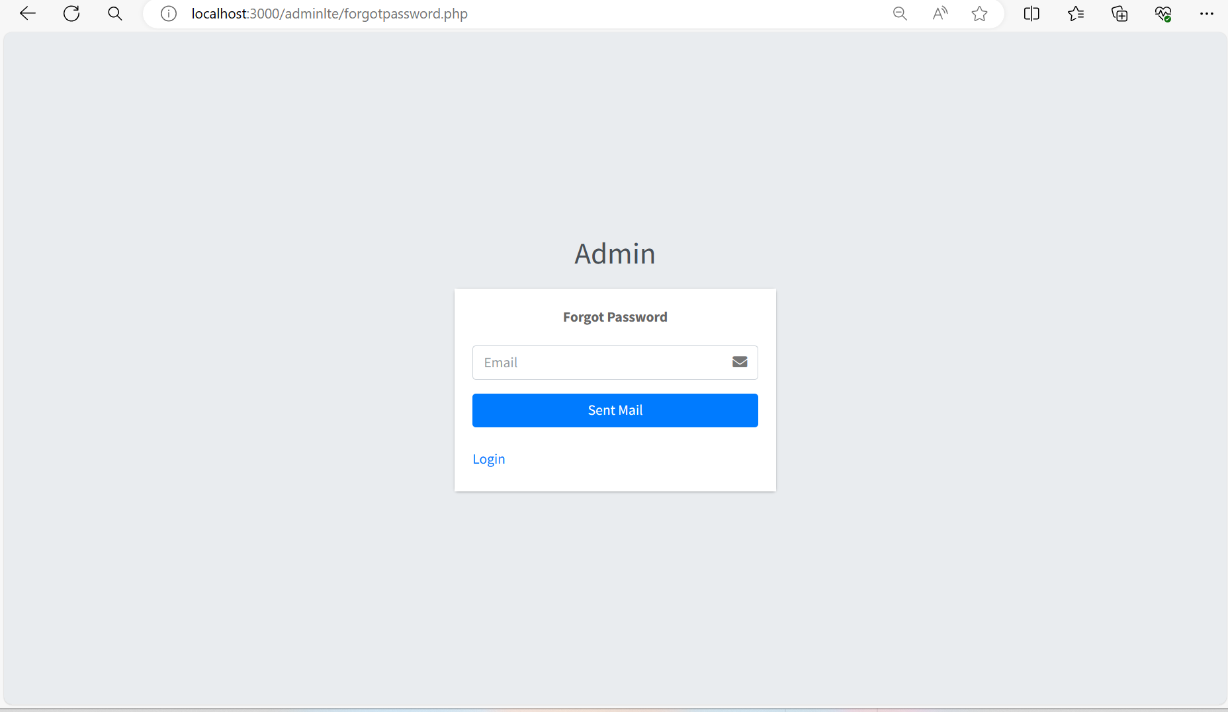
Forgot Password:

Slide 70
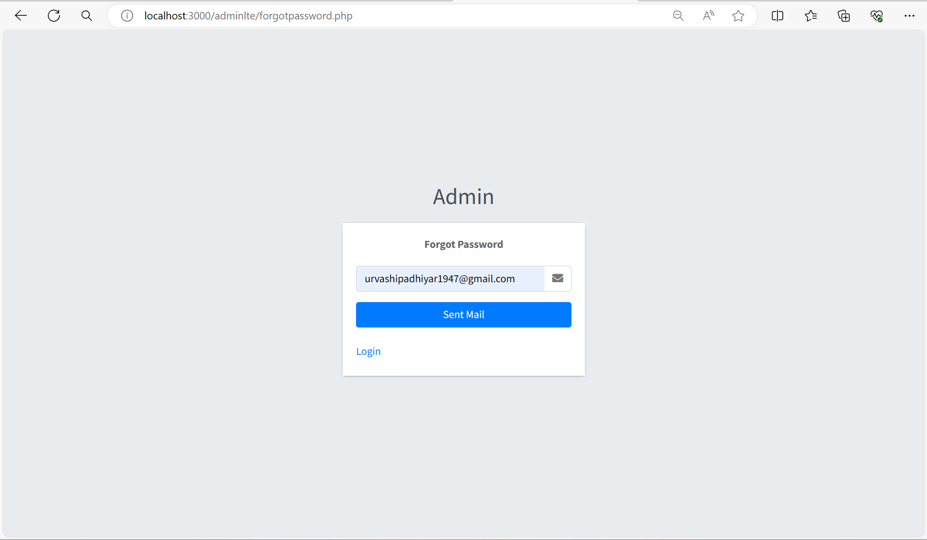
Forgot Password with Data:

Slide 71
Forgot Password with Data:

Slide 72
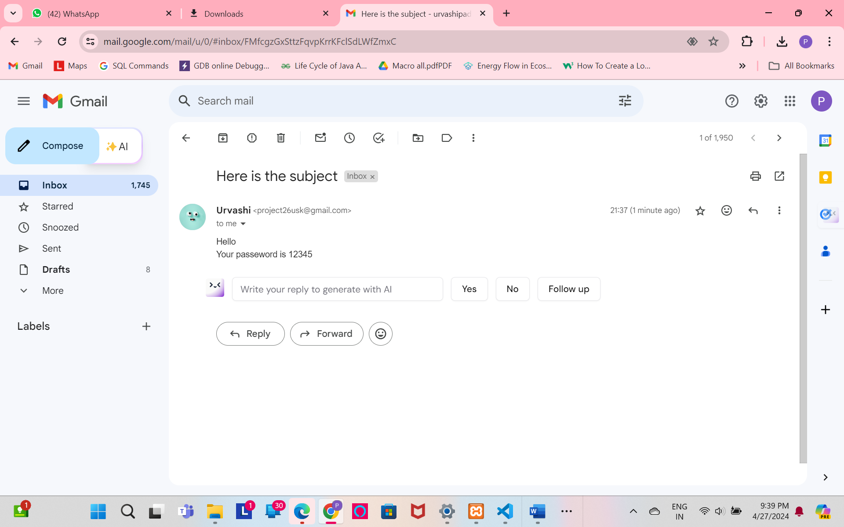
Email of forgot password:

Slide 73
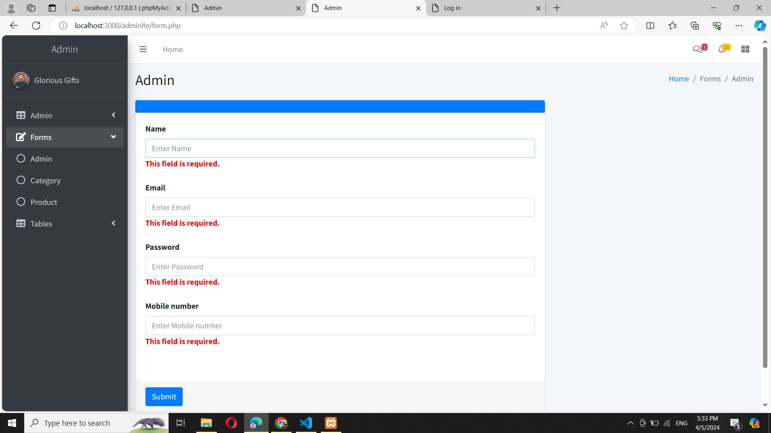
Admin Form:

Slide 74
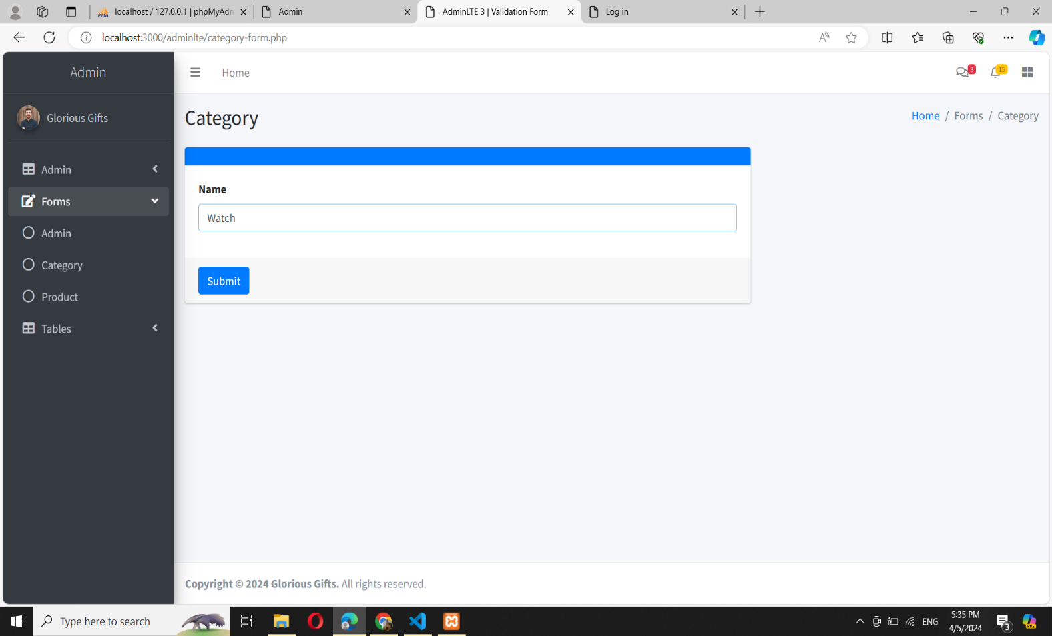
Add Category:

Slide 75
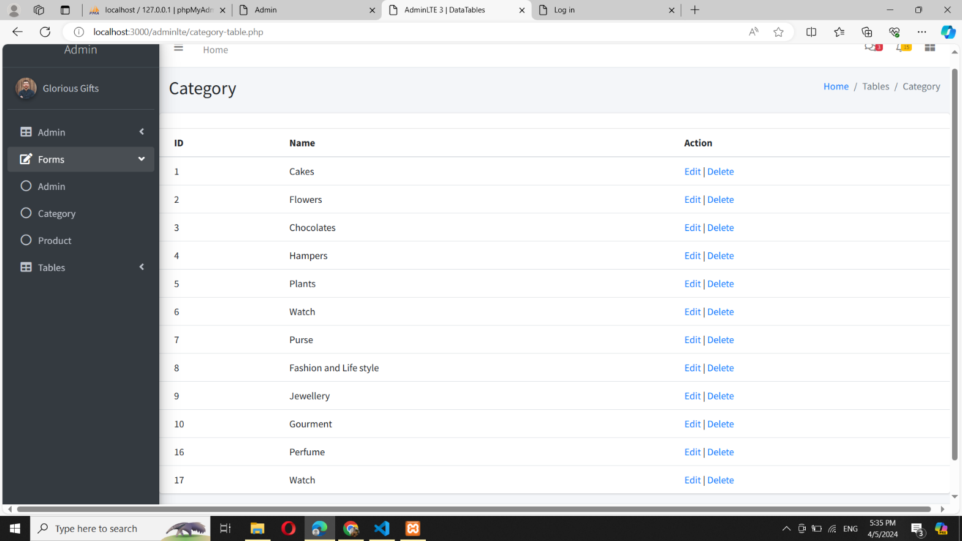
Display Category:

Slide 76
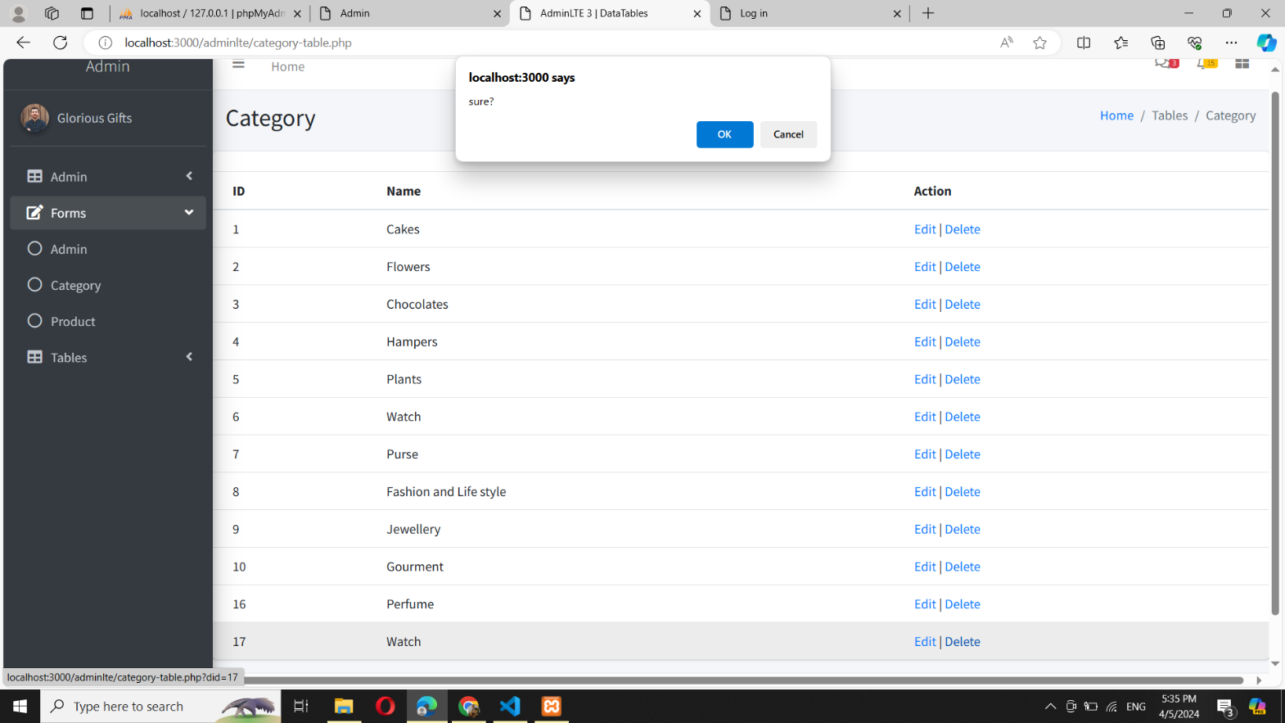
Delete Category:

Slide 77
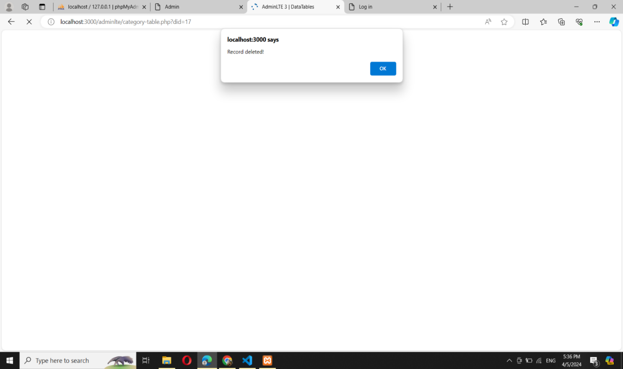
Category deleted:

Slide 78
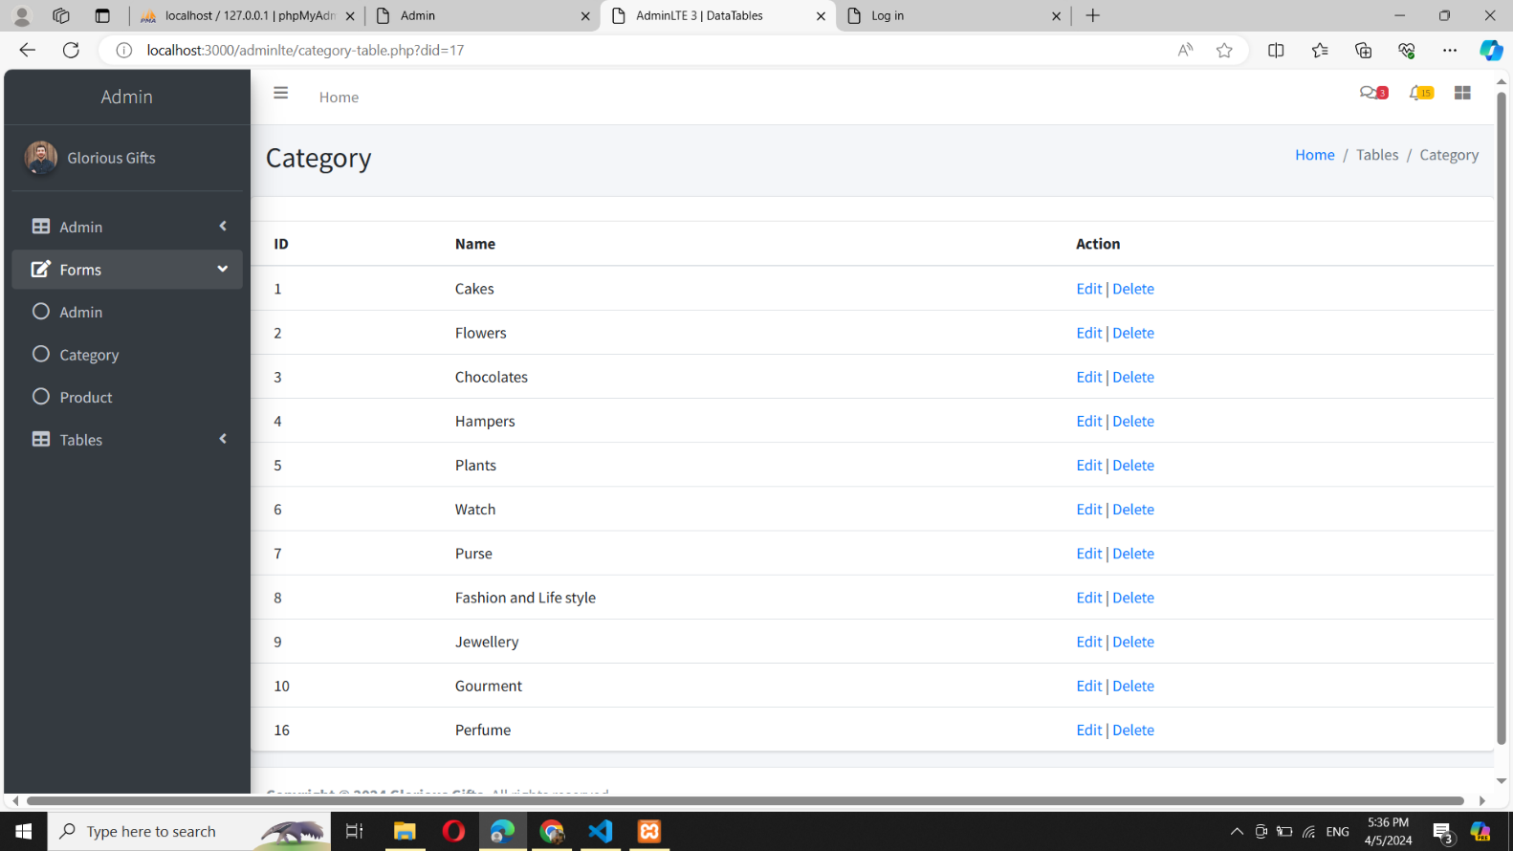
Category deleted from table:

Slide 79
Delete Category:

Slide 80

Edit Category:

Slide 81
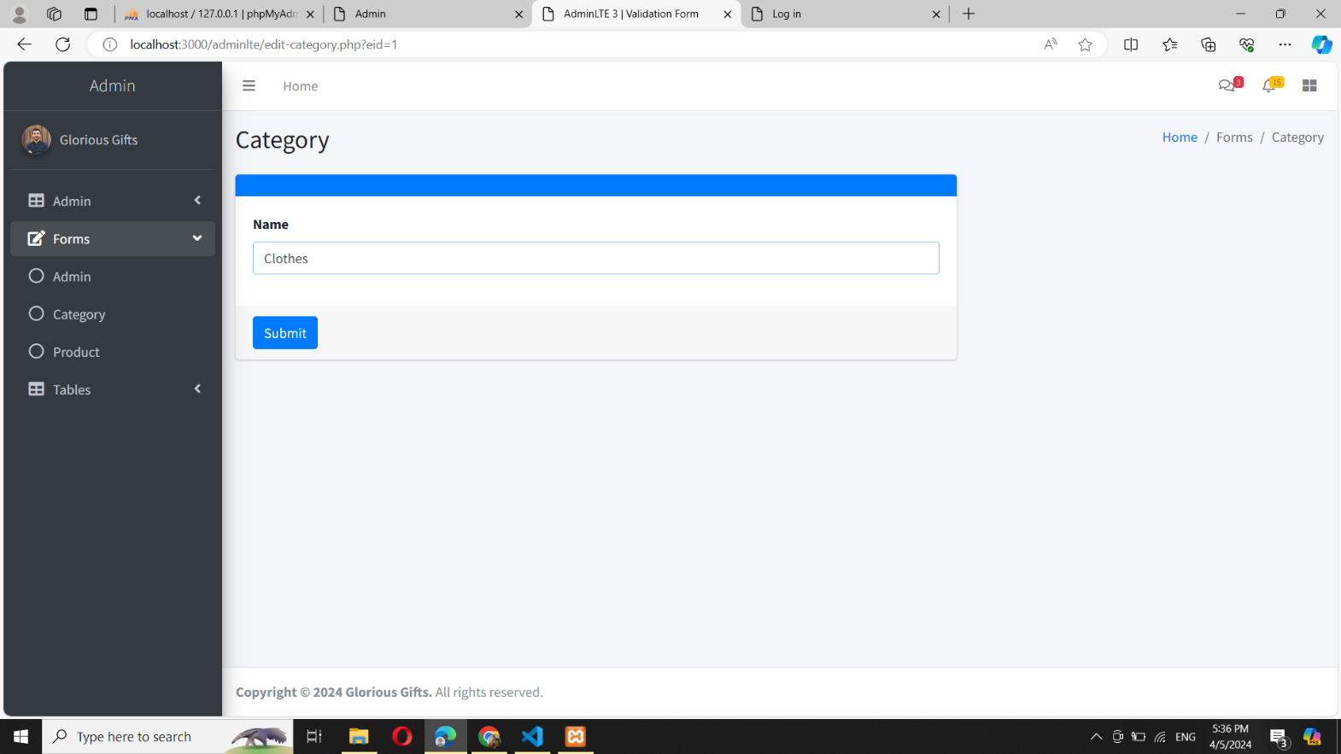
Edit Category:

Slide 82

Category updated:

Slide 83

Category updated in Table:

Slide 84
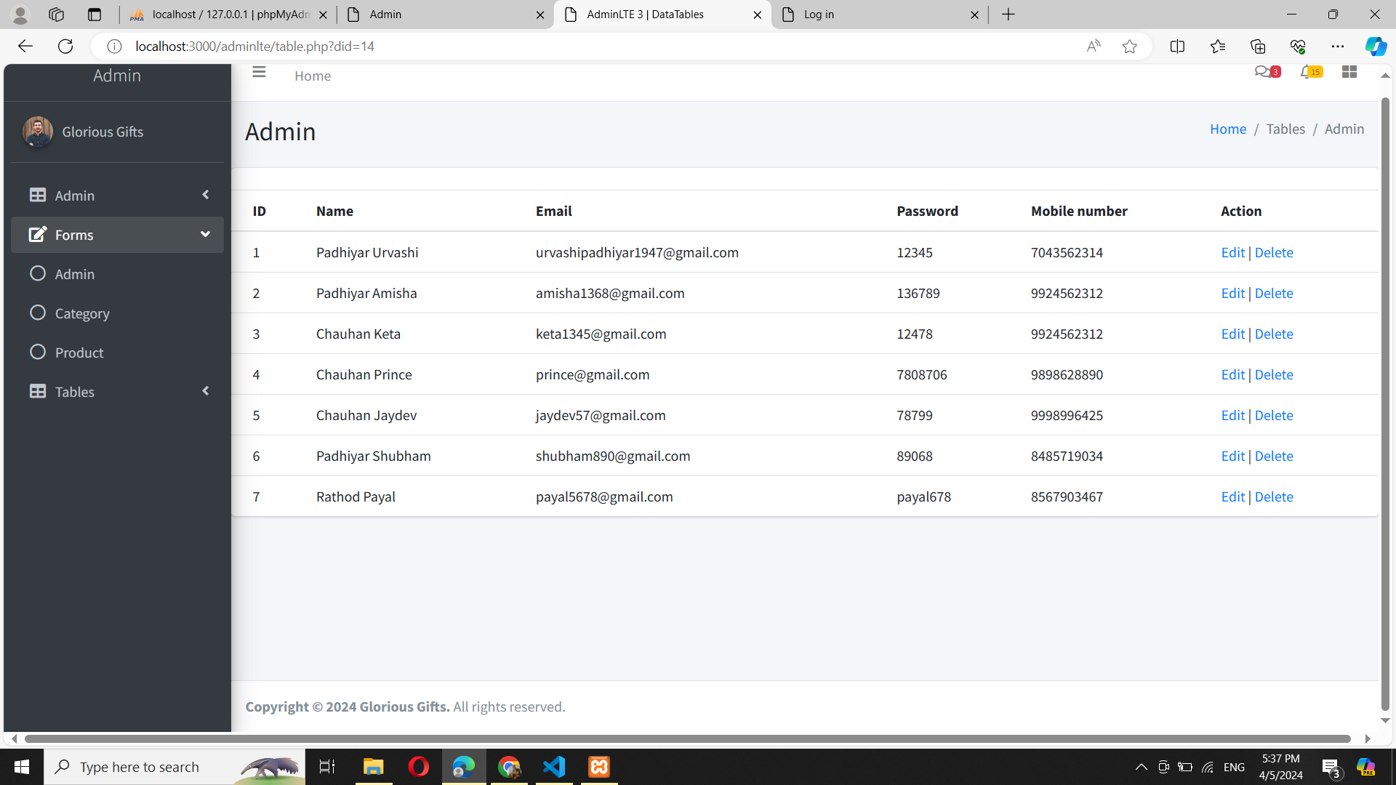
Admin Table:

Slide 85
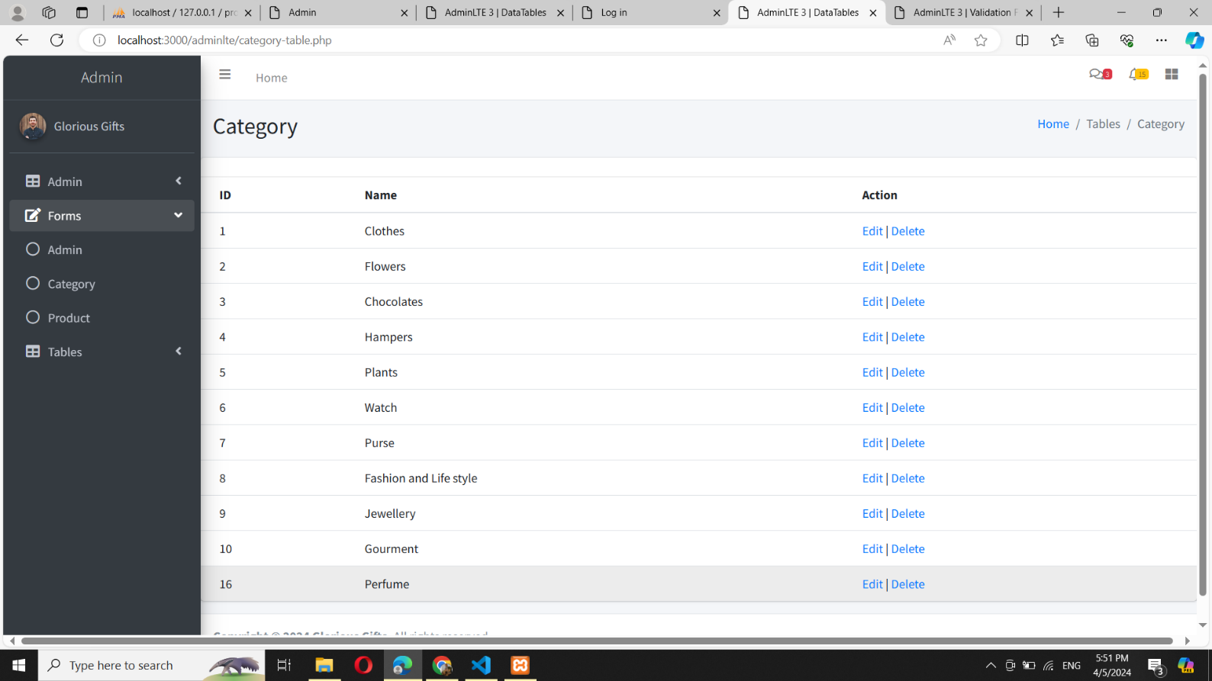
Category Table:

Slide 86
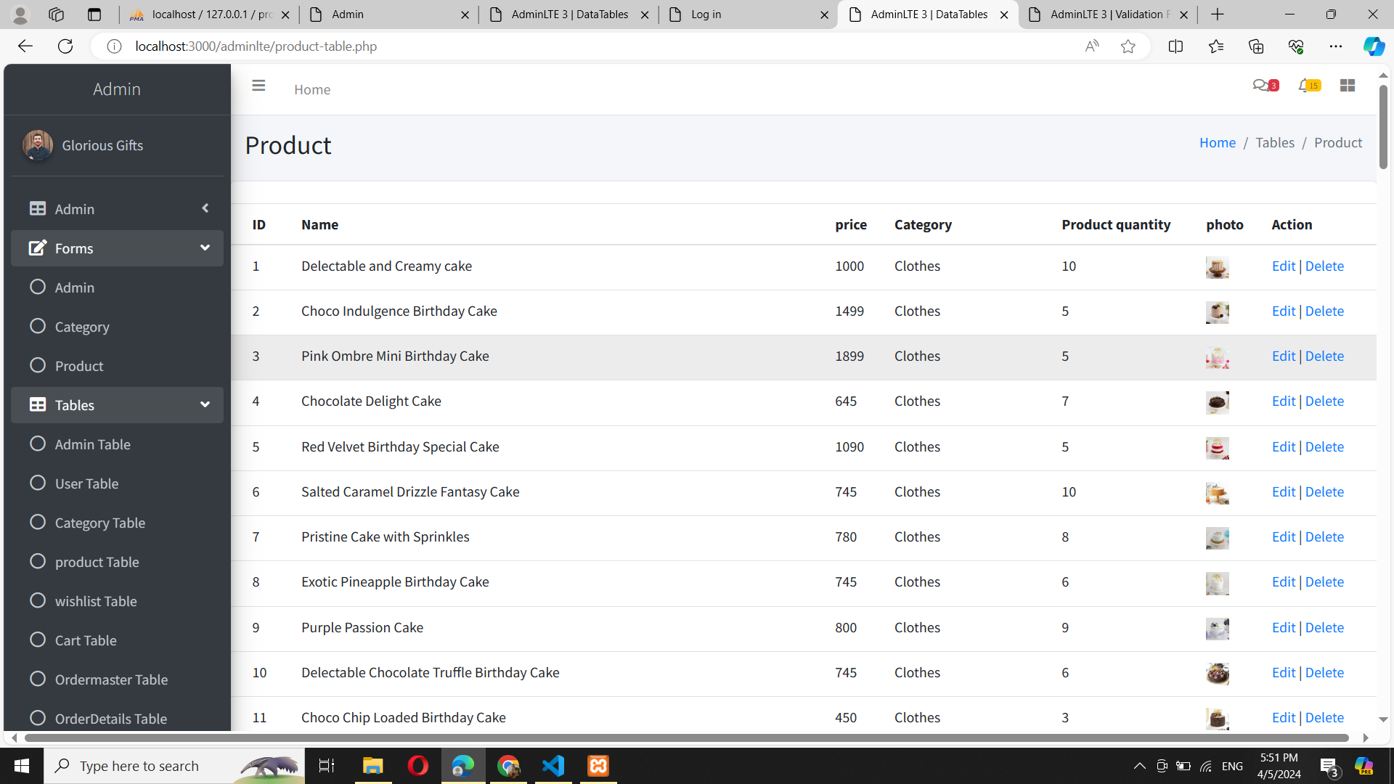
Product Table:

Slide 87
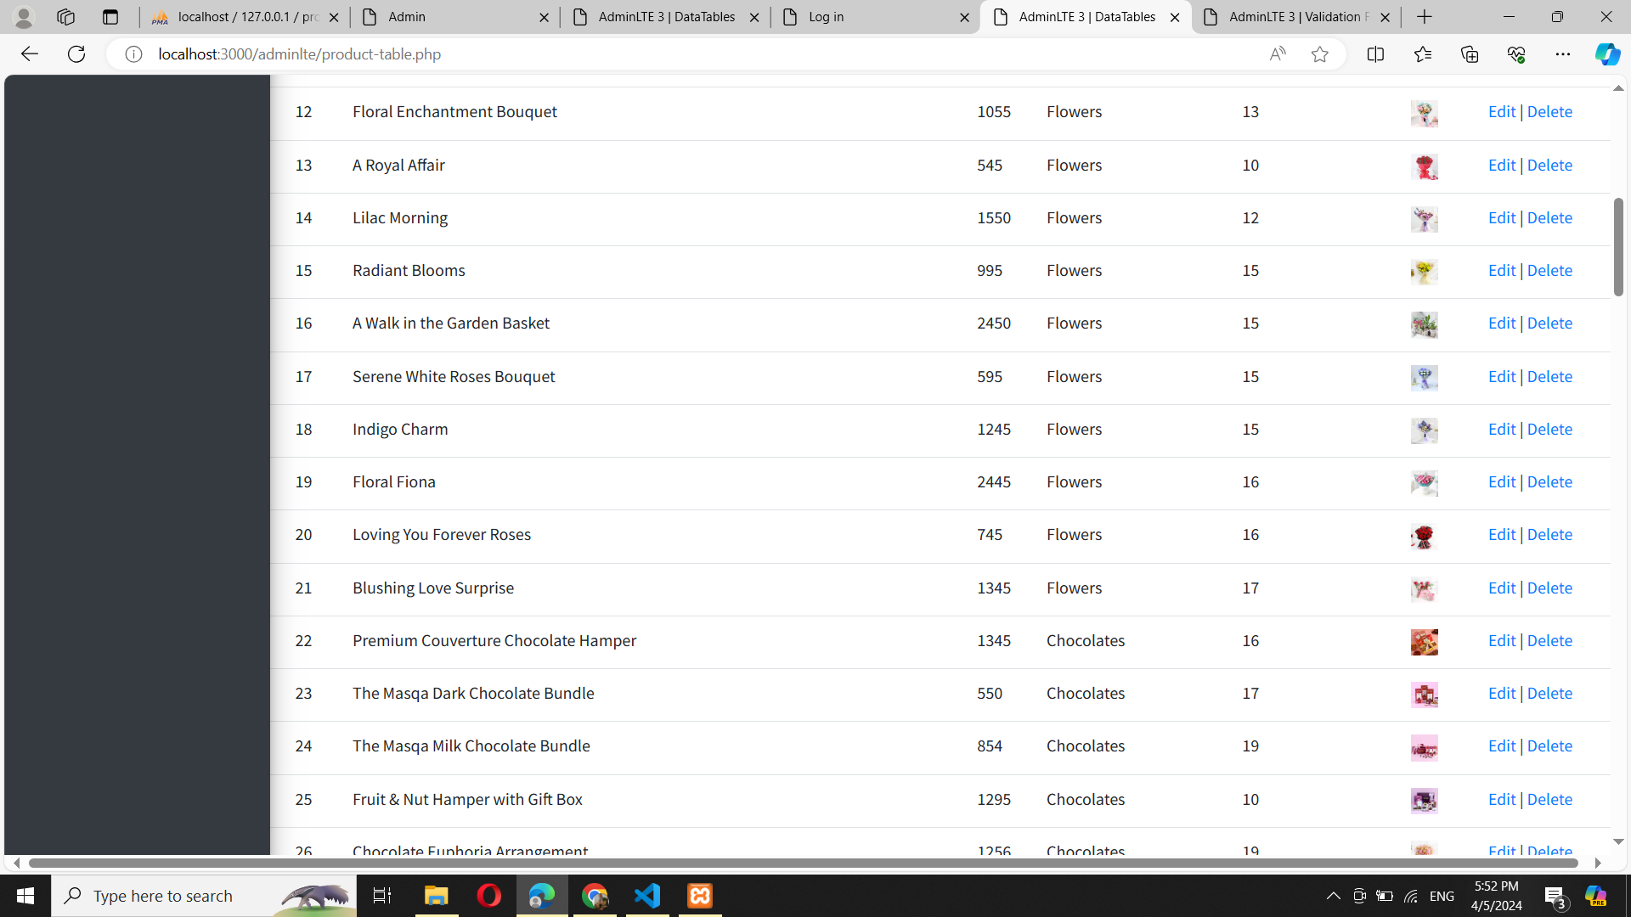
Product Table:

Slide 88
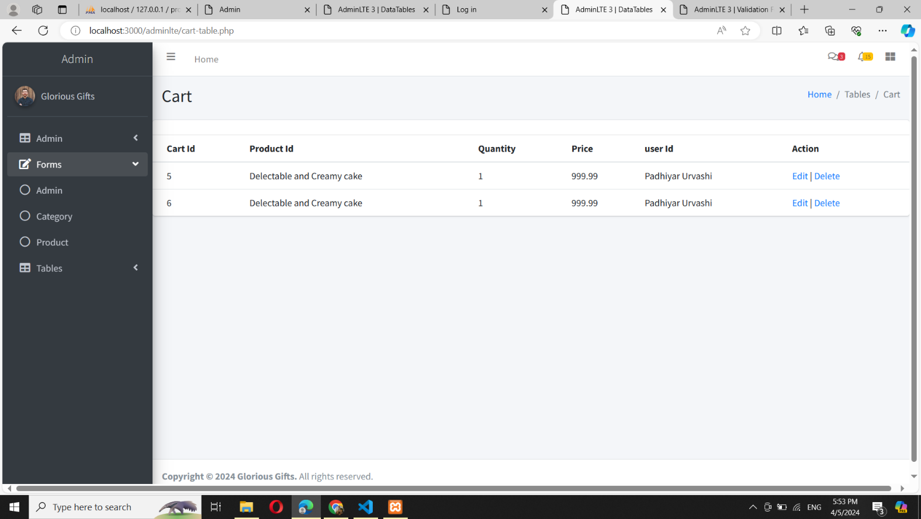
Cart Table:

Slide 89
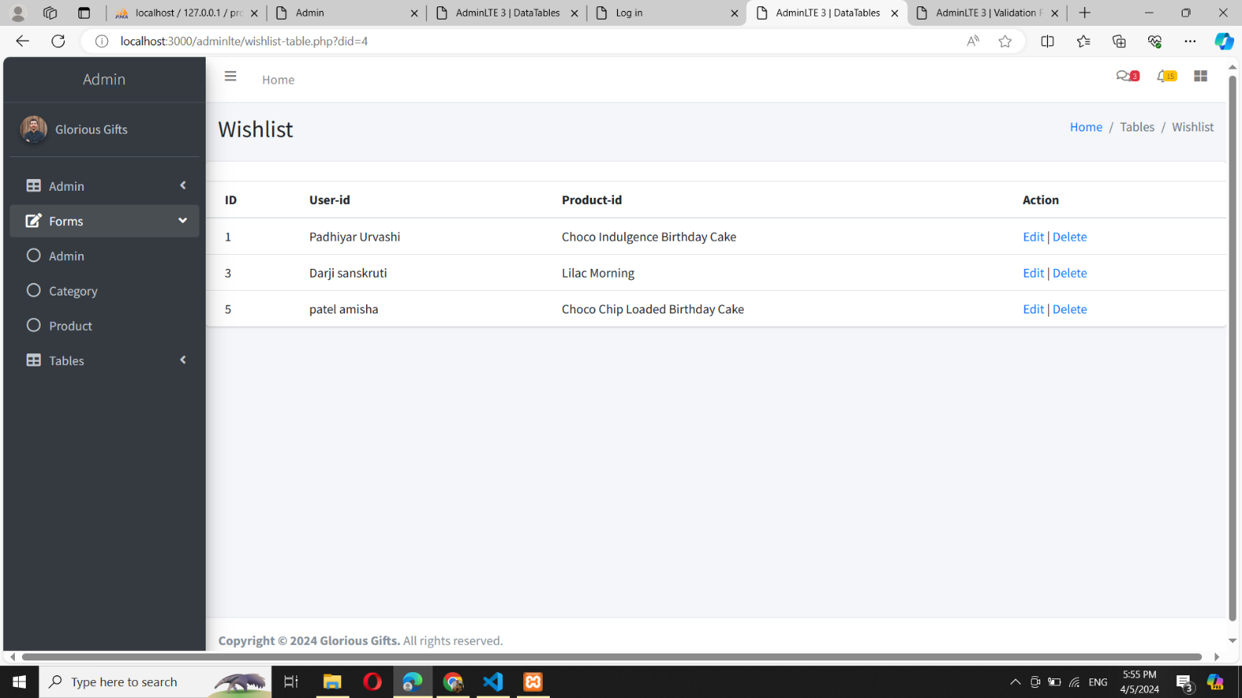
Wishlist Table:

Slide 90
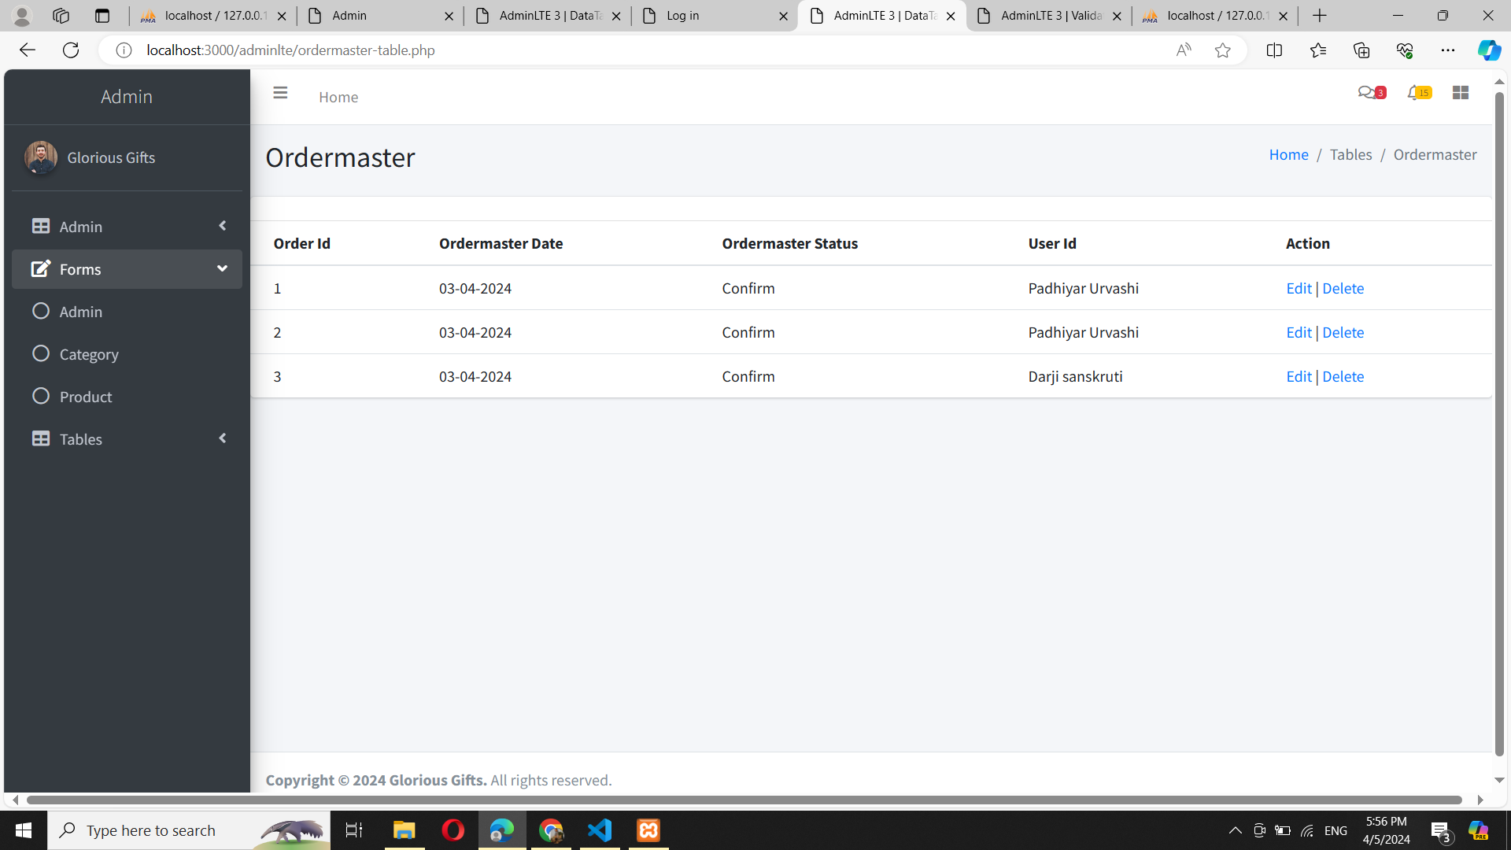
Ordermaster Table:

Slide 91
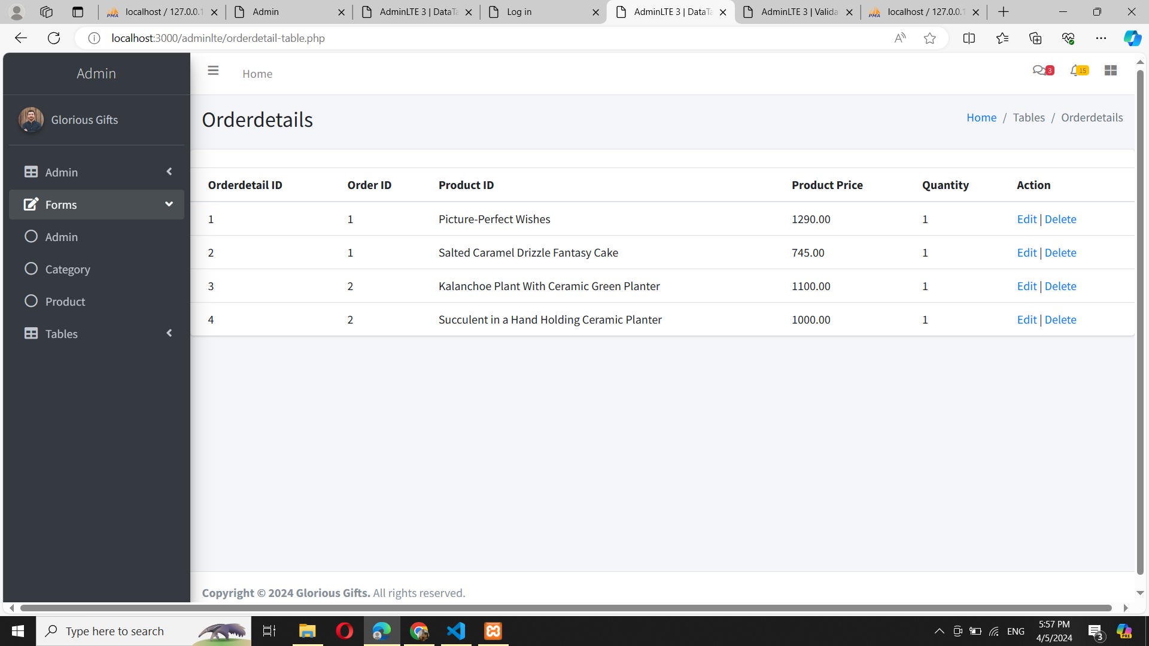
Orderdetails Table:

Slide 92
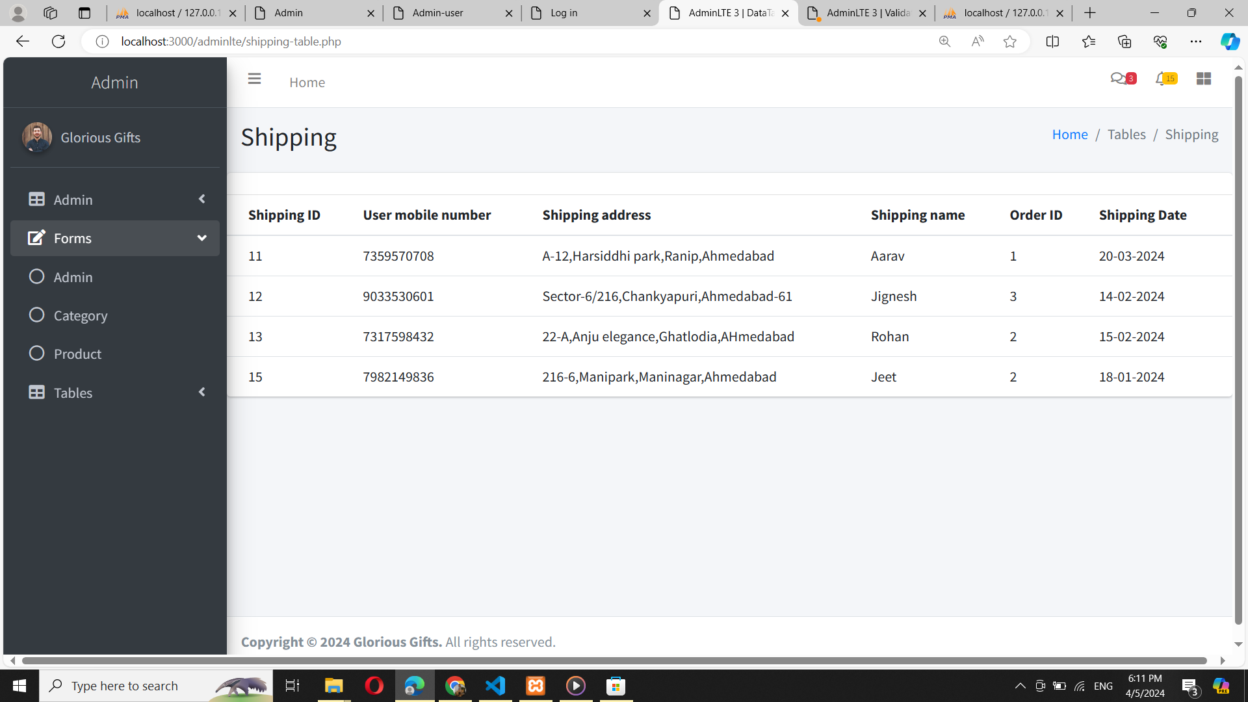
Shipping Table:

Slide 93
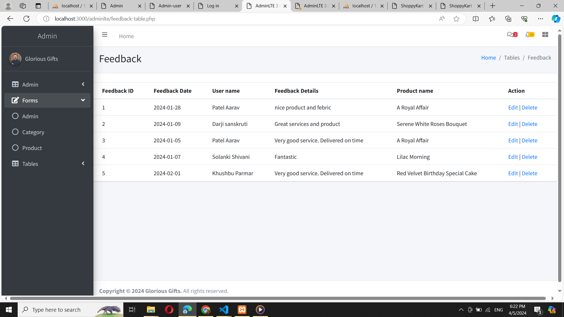
Feedback Table:

Slide 94
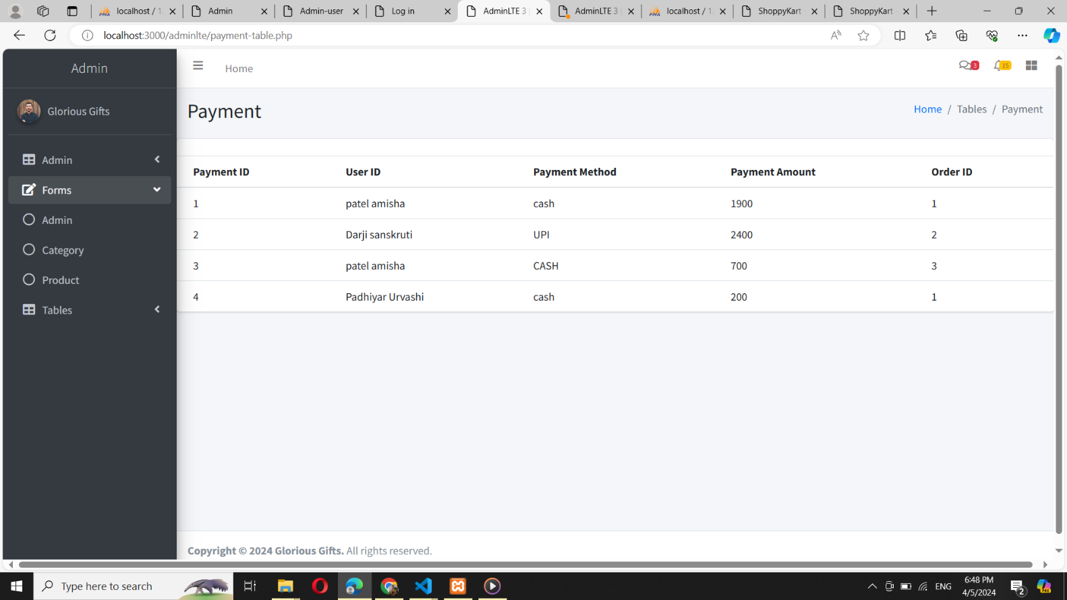
Payment Table:

Slide 95

User Panel:
Home Page:

Slide 96

Home Page:

Slide 97

Categories on Home Page:

Slide 98

User on Home Page:

Slide 99

Search bar:

Slide 100

Home Page:

Slide 101

Pestimonials:

Slide 102

Home Page:

Slide 103

Footer:

Slide 104

About Us:

Slide 105

Contact Us:

Slide 106

Sign Up:

Slide 107

Sign Up with validation:

Slide 108

Login:

Slide 109

Login with Validation:

Slide 110

Change Password:

Slide 111

Change Password with Validation:

Slide 112

Forgot Password:

Slide 113

Forgot Password with Validation:

Slide 114

Forgot Password email:

Slide 115

Product List:

Slide 116

Product List:

Slide 117

Product List:

Slide 118

Product List:

Slide 119

Product Detail:

Slide 120

Add to Cart:

Slide 121

Shipping:
Cash:

Slide 122

UPI:

Slide 123

Card:

Slide 124

Shipping Validation:

Slide 125

Order Placed:

Slide 126

View Order:

Slide 127

Order Details:

Slide 128

Feedback:

Slide 129

Feedback with Validation:

Slide 130

Wishlist:

Slide 131

Invoice:

Slide 132

Suggestion Box:

Slide 133

Suggestion Box:

Slide 134

Suggestion Box:

Slide 135

Suggestion Box:

Slide 136

Suggestion Box:

Slide 137

Whatsapp Chat:

Slide 138
Bibliography: -
Bibliography are special reference works that are used to identify as many published works on a giving subject as possible, and serve as compilations for other authors or researches.
References:
Books
▪ Software Engineering – A practitioner’s Approach
-By Roger S. Pressman
▪ Analysis and Design of Information Systems
-By James A.Senn
Website
▪ www.w3schools.com
▪ draw.io (diagrams.net)

Slide 139
THANK YOU!

